Slide 1
User
Customer goes to website to review options for accounts. They click through the website and find information about the accounts and would like to come in and speak with a bank representative in person to review the details and potentially open a new account. They see a chat option and initiate a chat to setup and appointment. Once scheduled, they close out of the website.

Slide 2
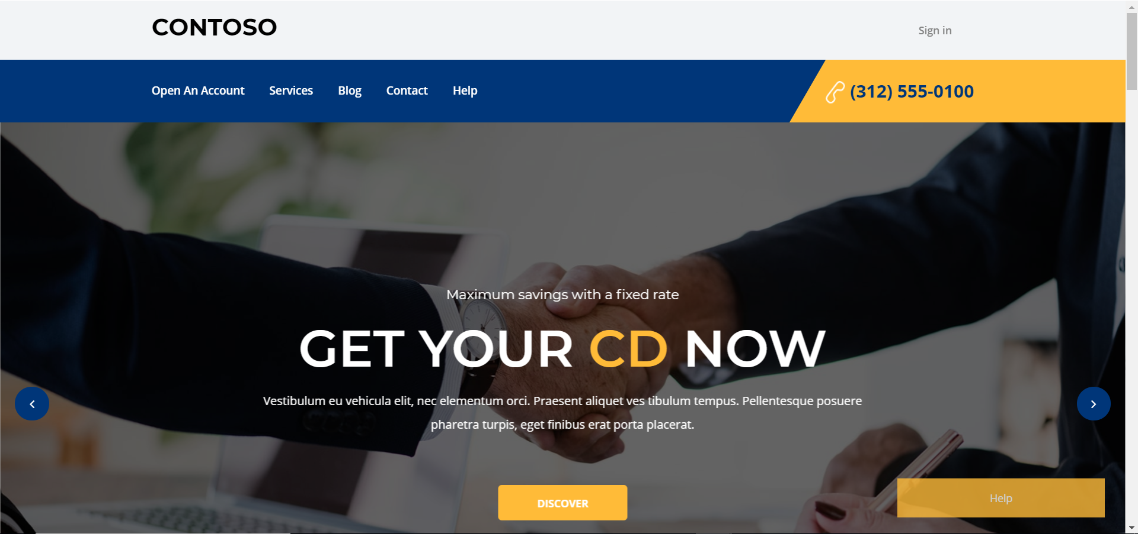

Slide 3
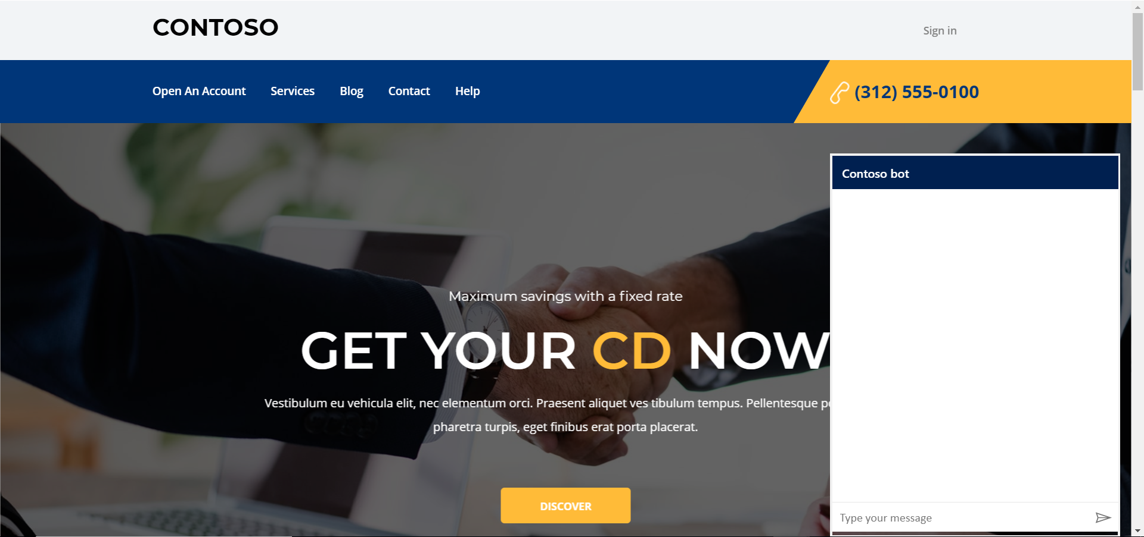

Slide 4
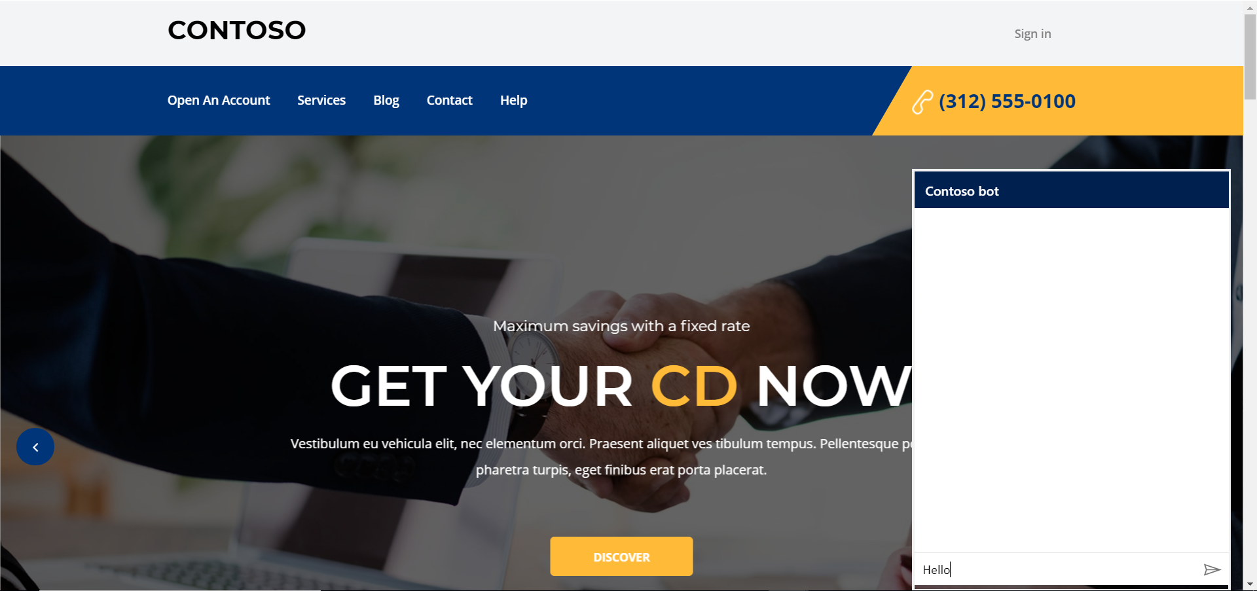

Slide 5
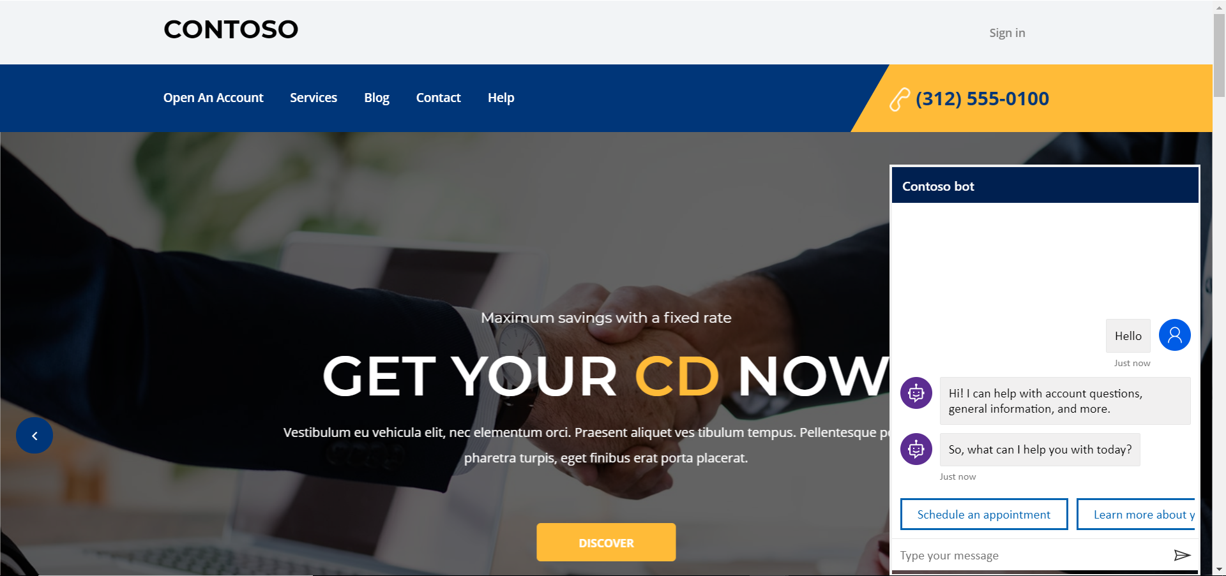

Slide 6
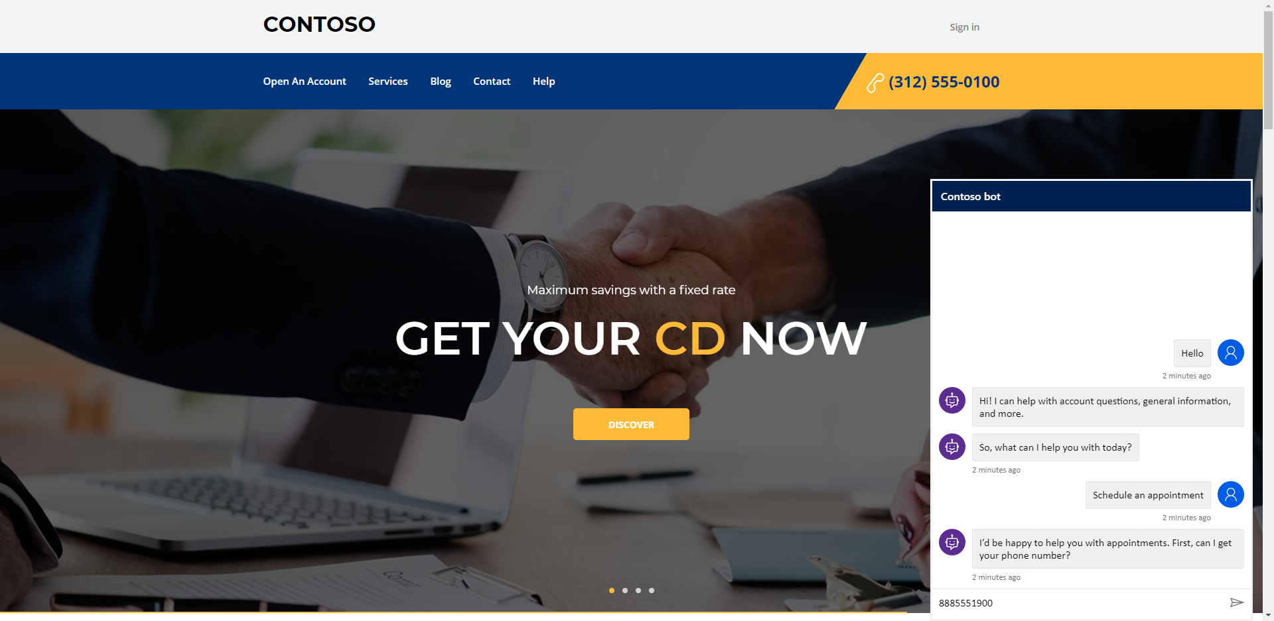

Slide 7
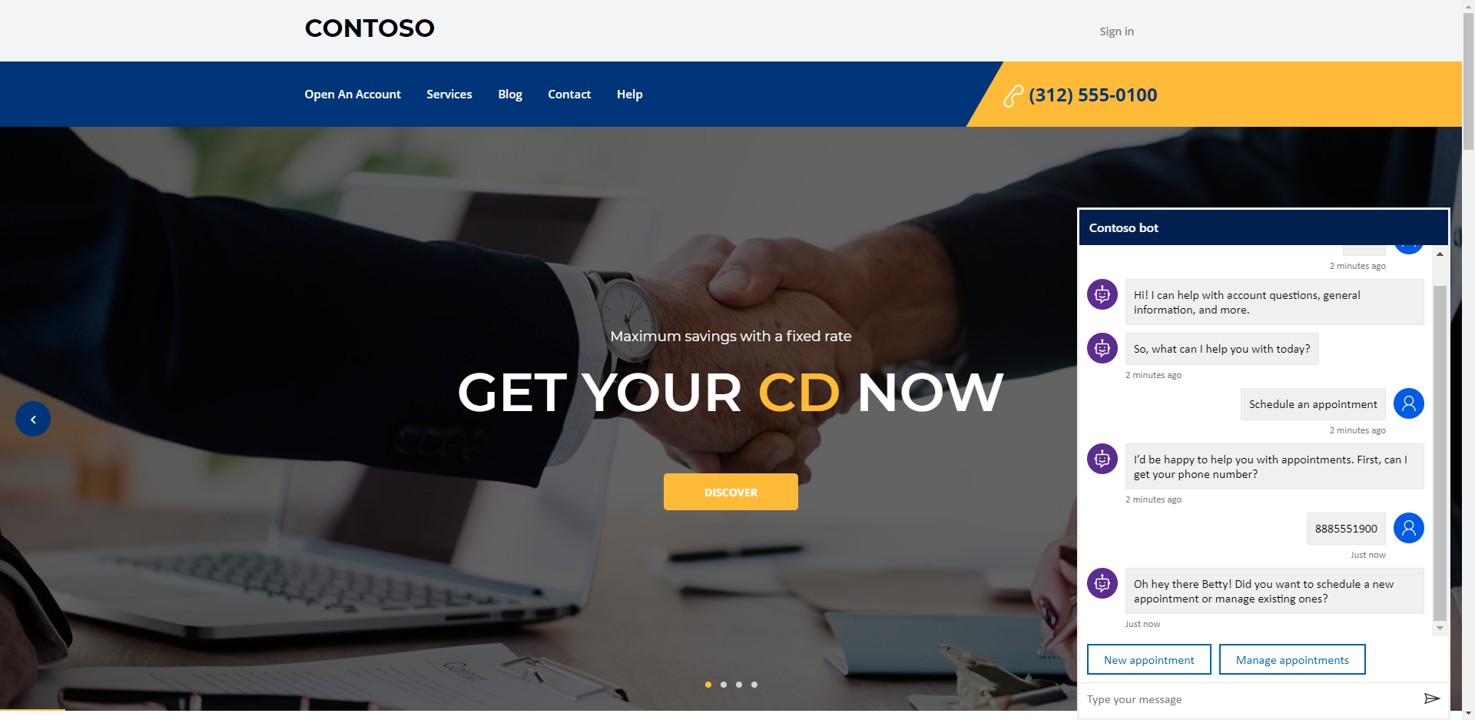

Slide 8
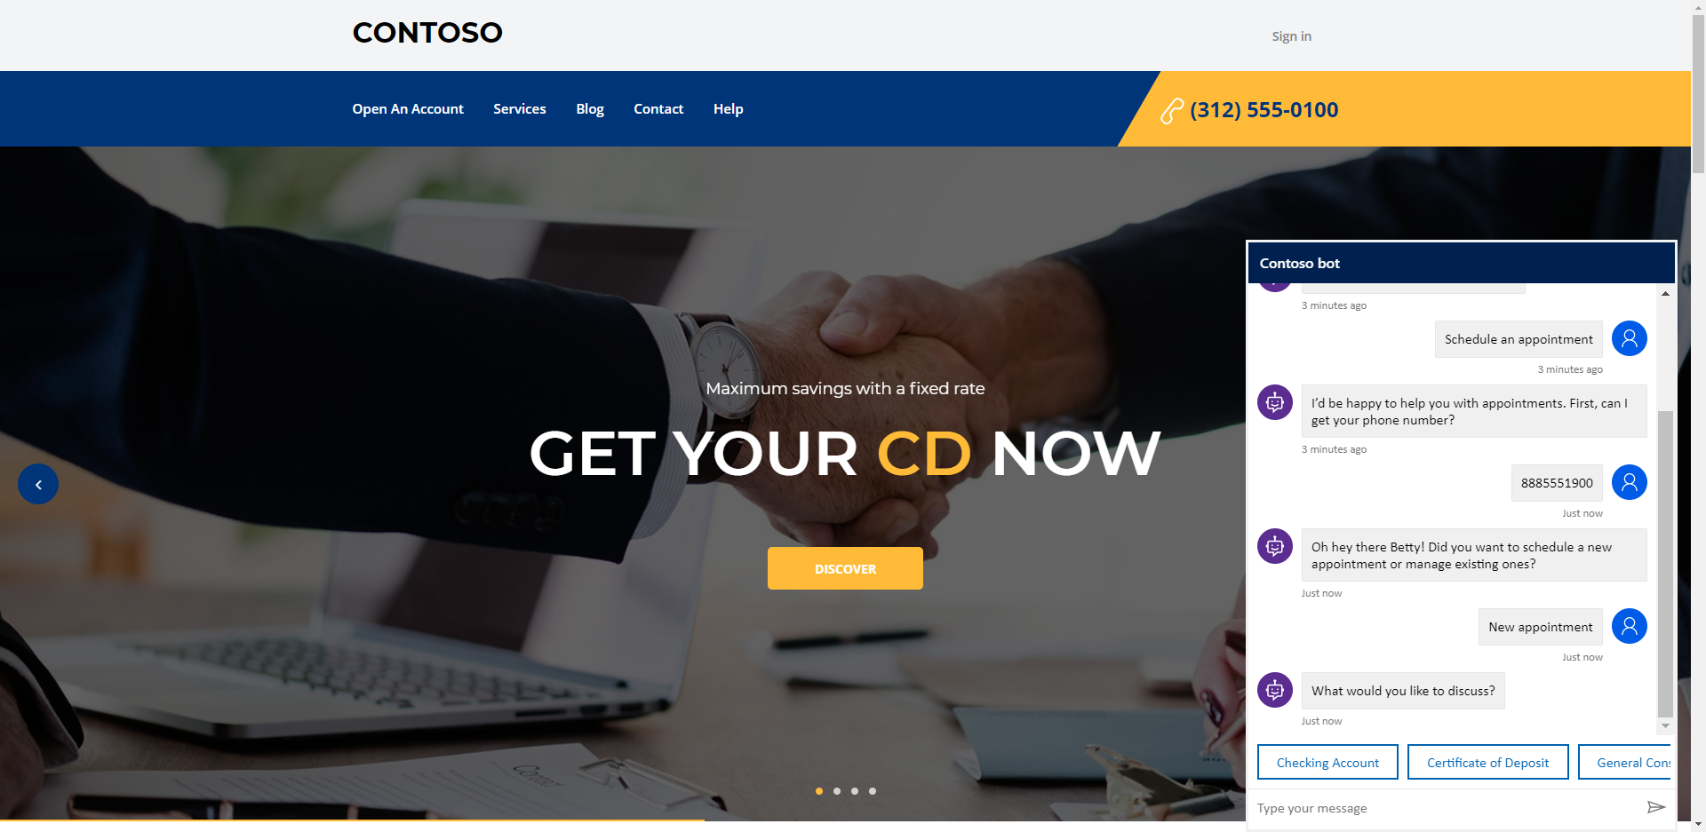

Slide 9
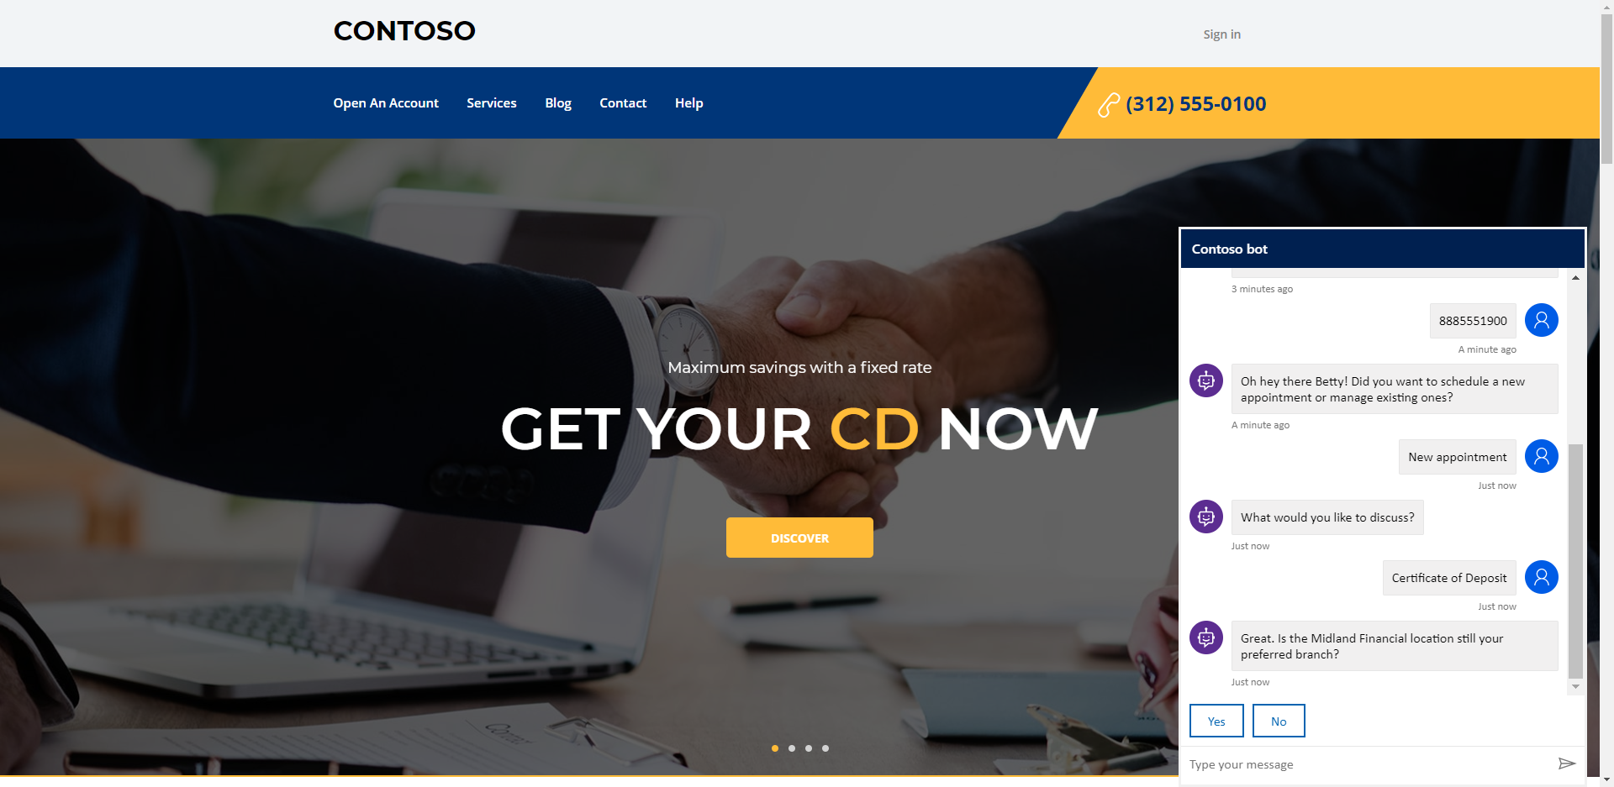

Slide 10


Slide 11
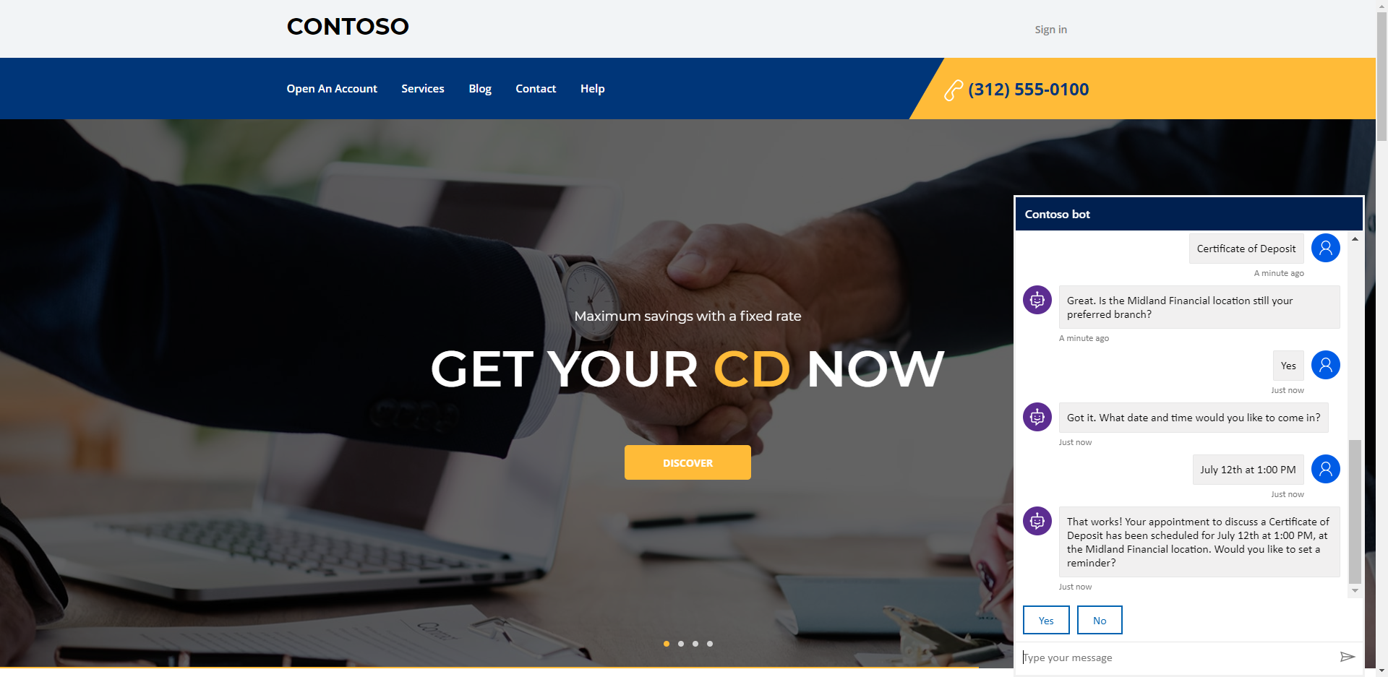

Slide 12
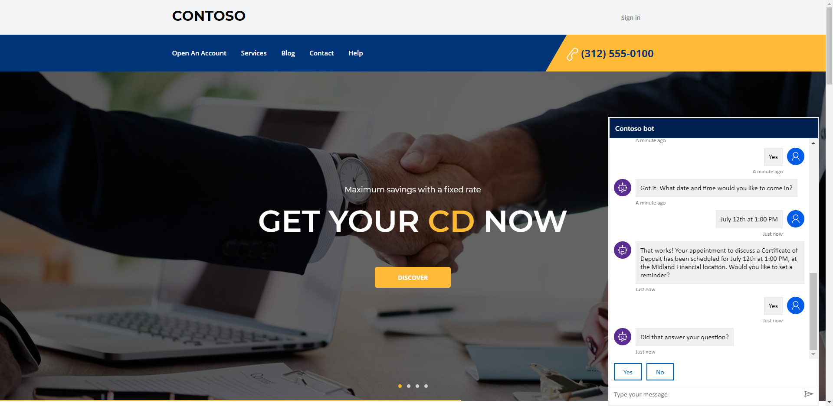

Slide 13
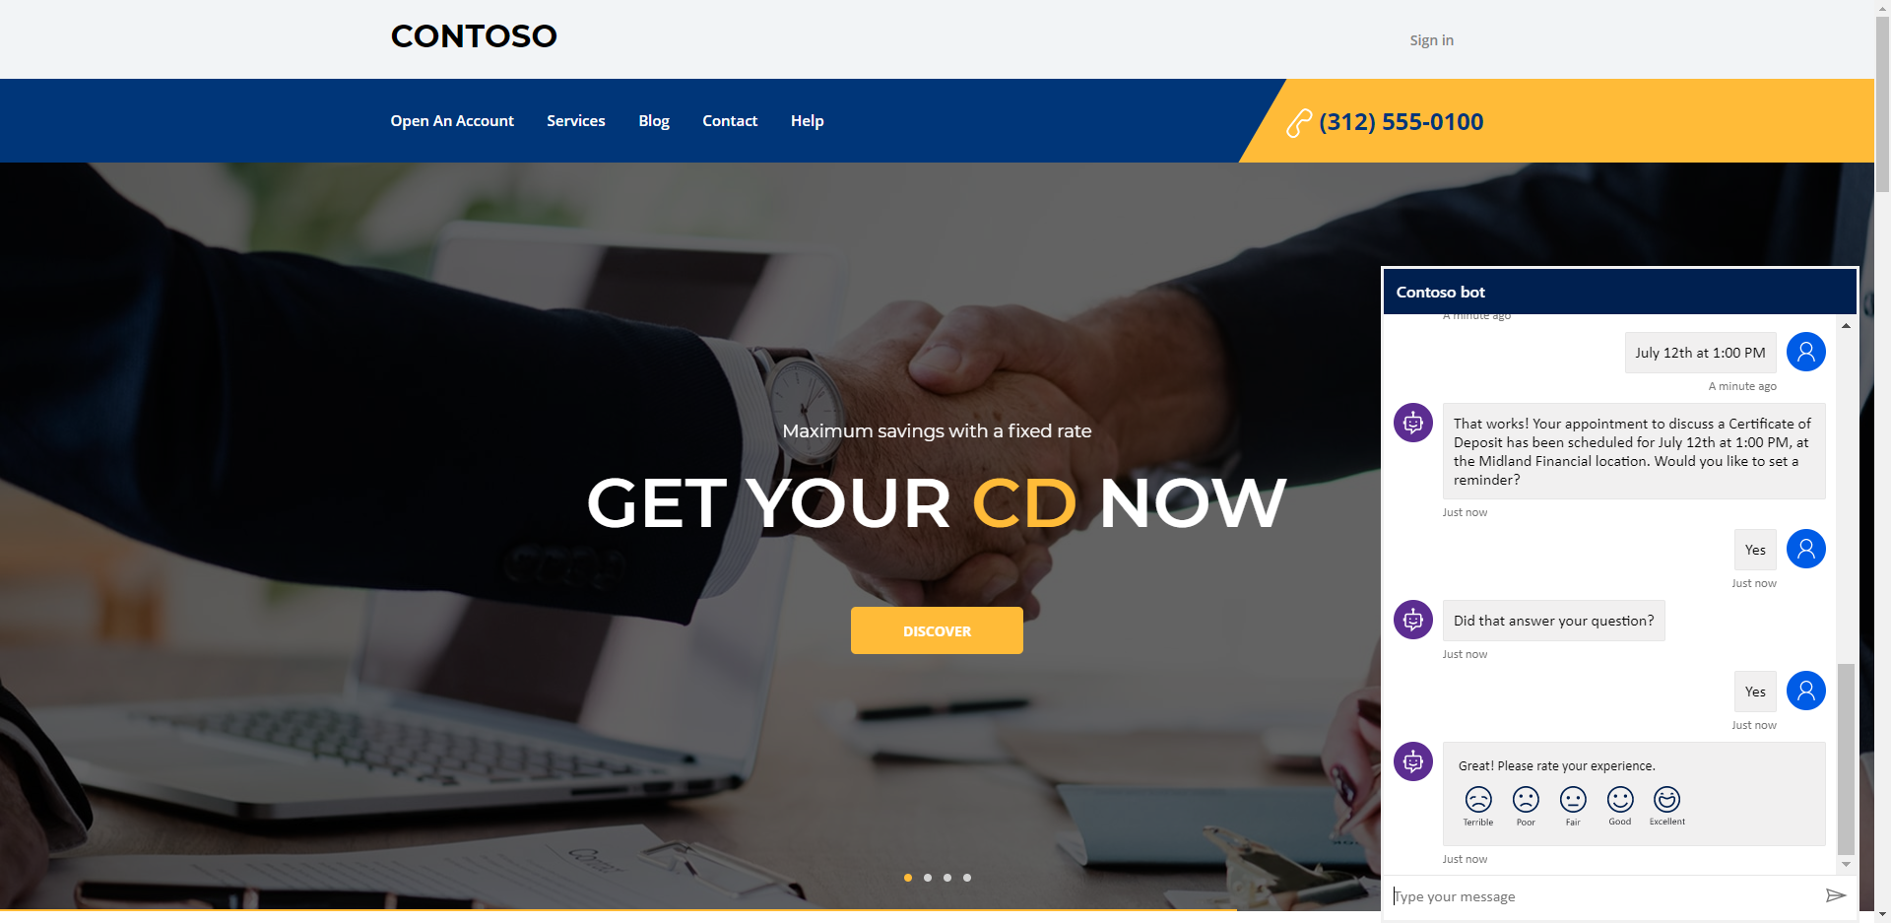

Slide 14


Slide 15
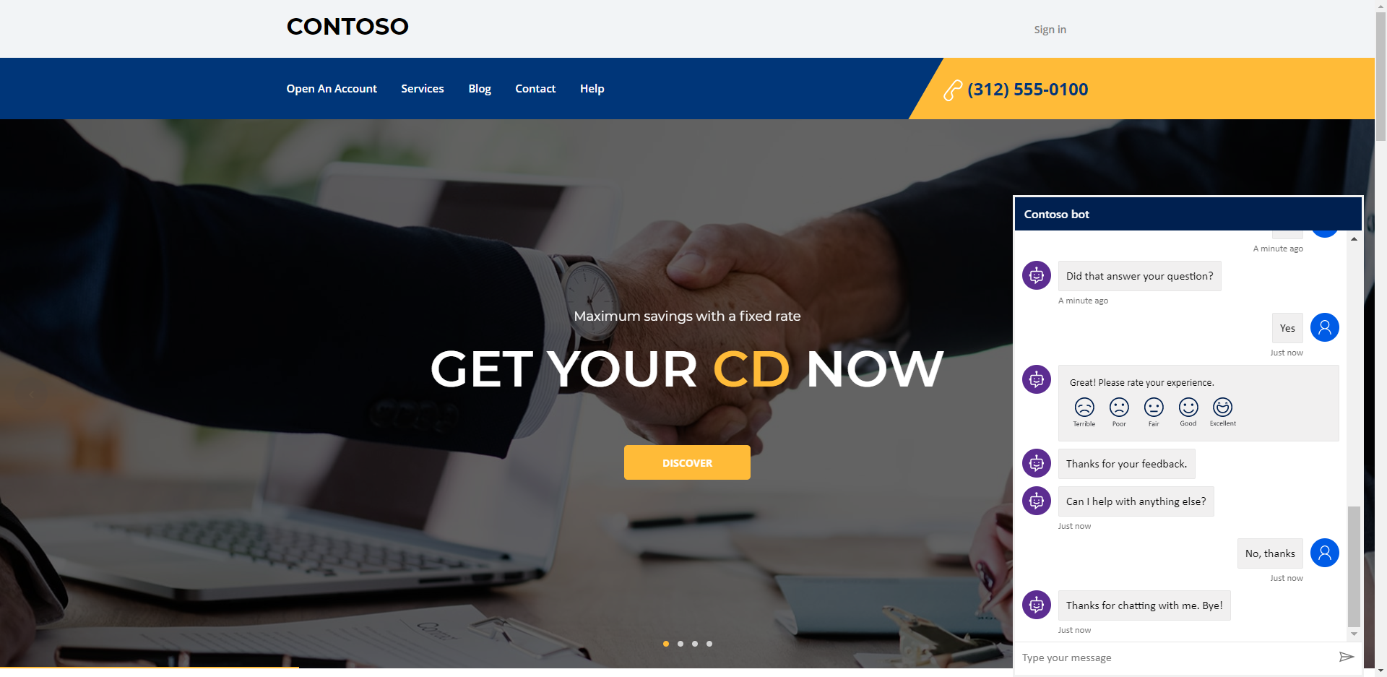

Slide 16
Relationship Manager
Relationship Manager logs in to Dynamics at the beginning of the day and views the Daily Dash dashboard. On this dashboard, they see that they have an appointment with an existing customer regarding a Certificate of Deposit. They review the Customer 360 prior to the appointment in order to be informed before the meeting.

Slide 17
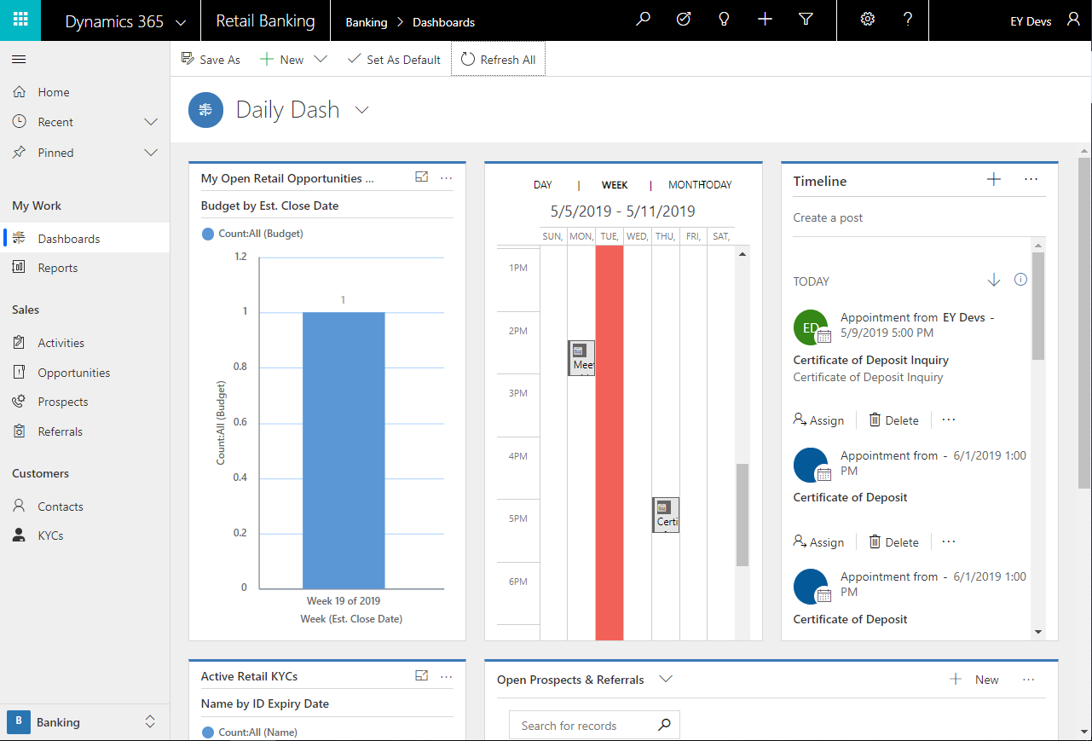

Slide 18
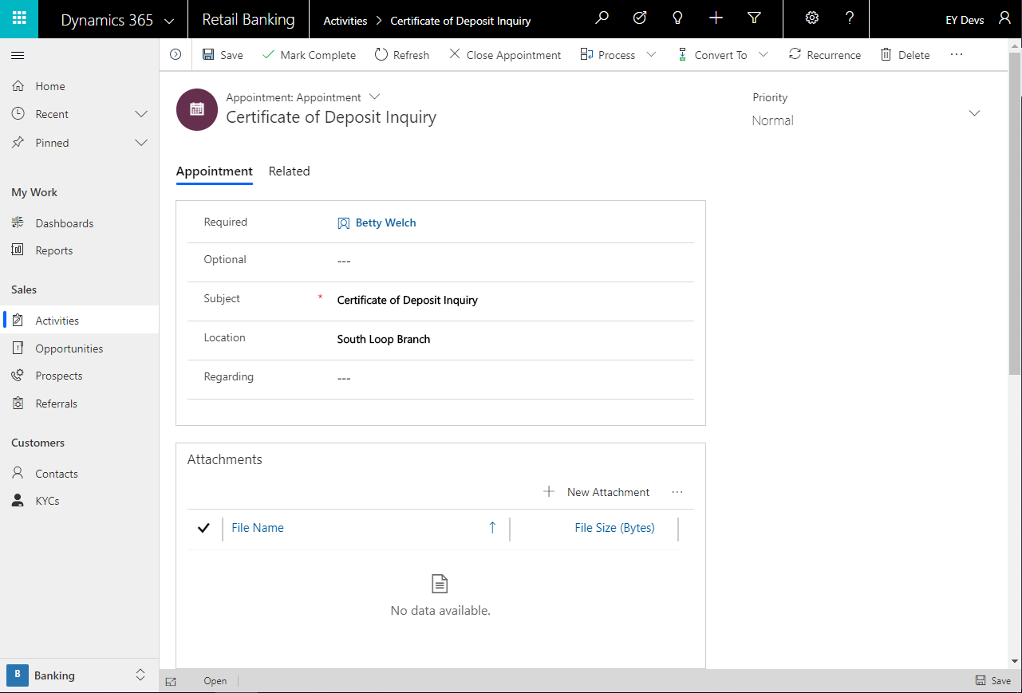

Slide 19
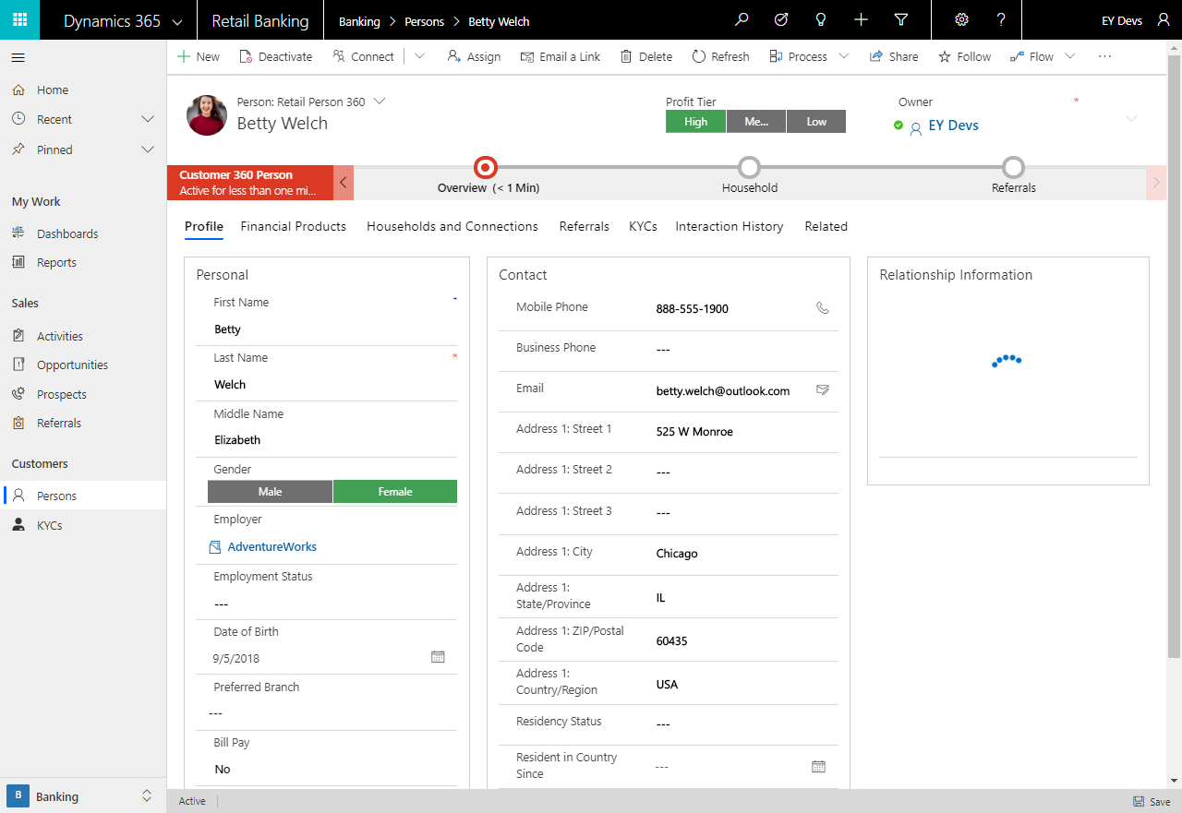

Slide 20
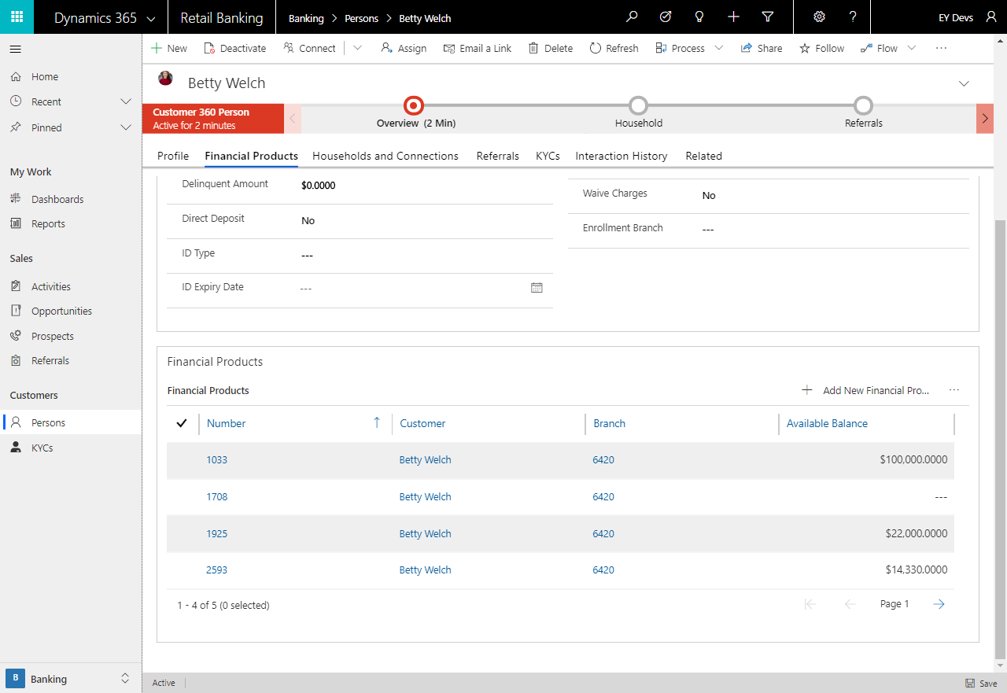

Slide 21
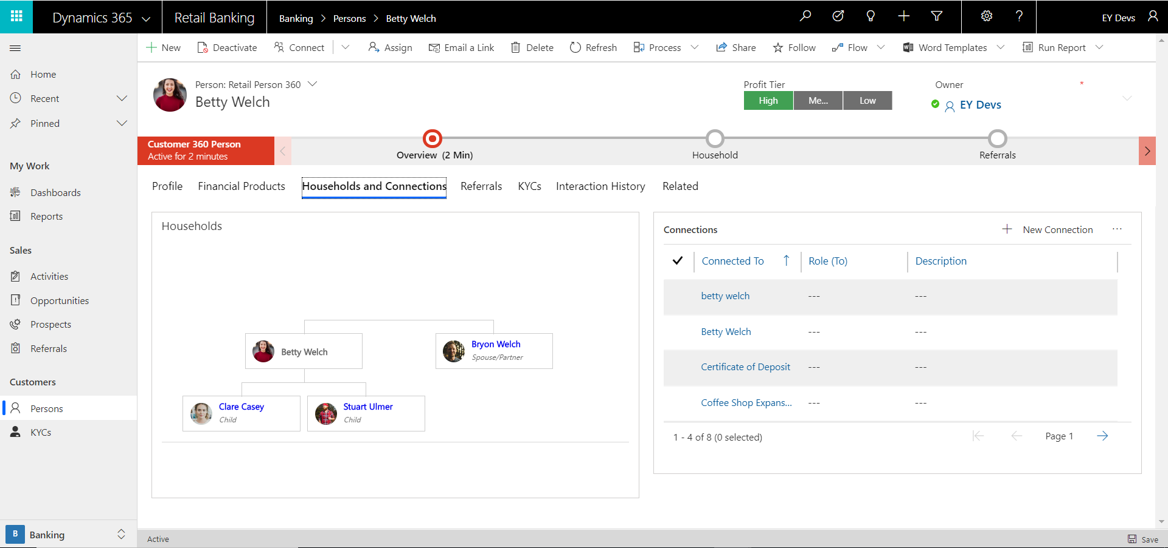

Slide 22
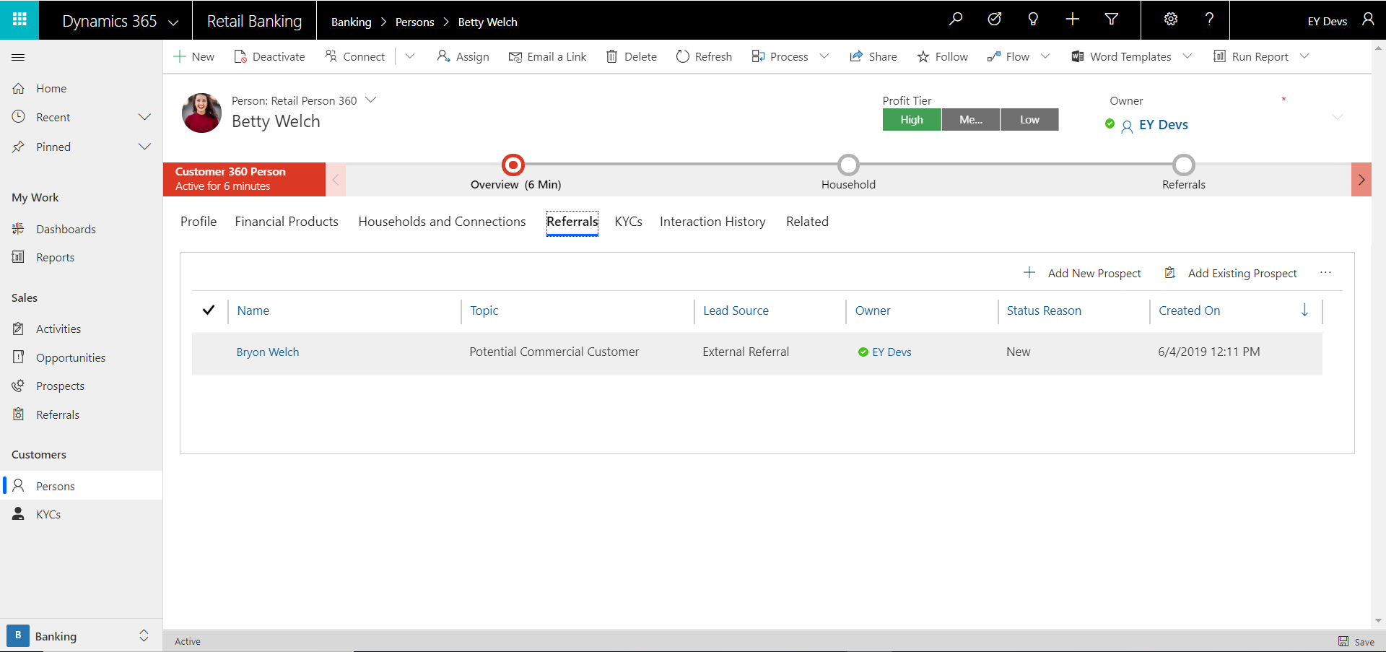

Slide 23
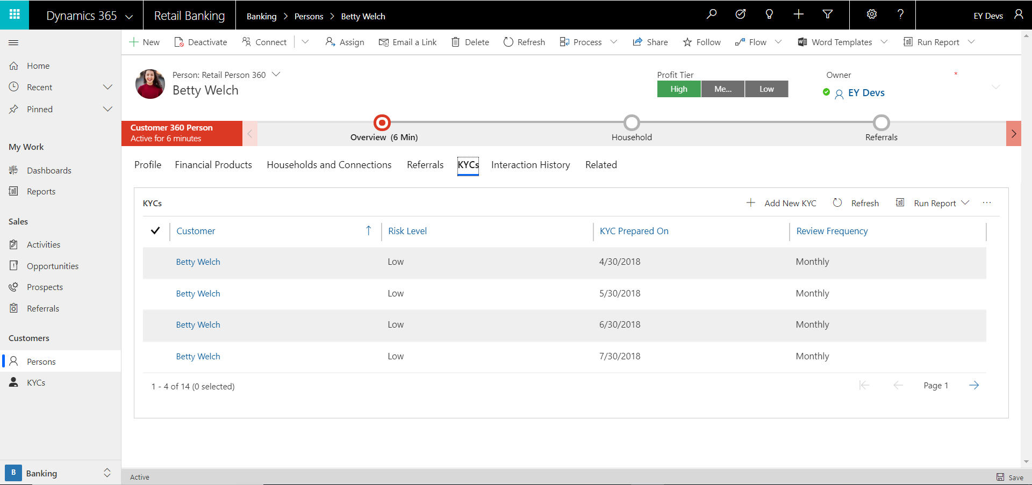

Slide 24
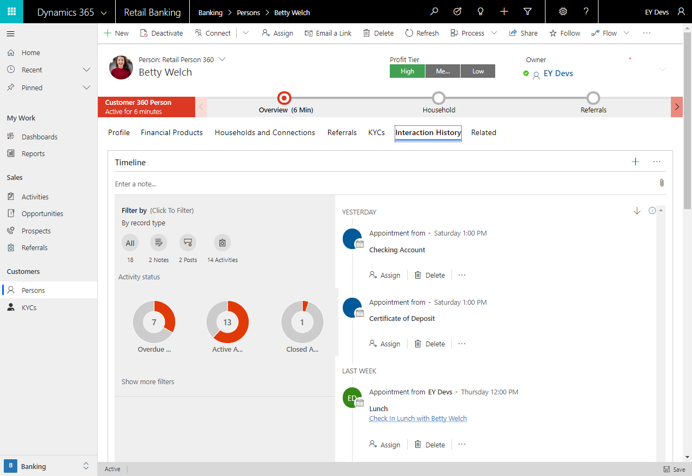

Slide 25
Relationship Manager
During the meeting, the relationship manager helps the person work through an application for a Certificate of Deposit. At the end of the appointment, the contact mentioned that they small business they have been working on is in need of a loan. The Retail Relationship Manager enters the referral for the Commercial Loan.
From the Customer 360 Form, the user will select the Process button in the application ribbon and go through to select the Certificate of Deposit process.

Slide 26
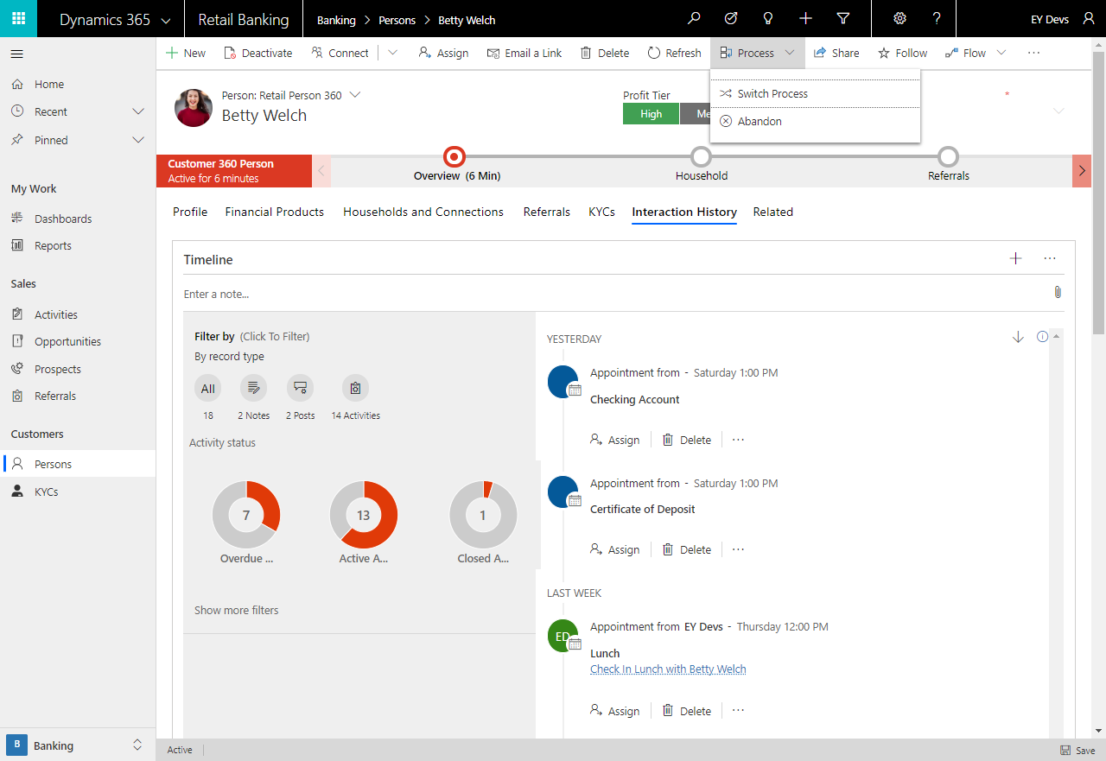

Slide 27
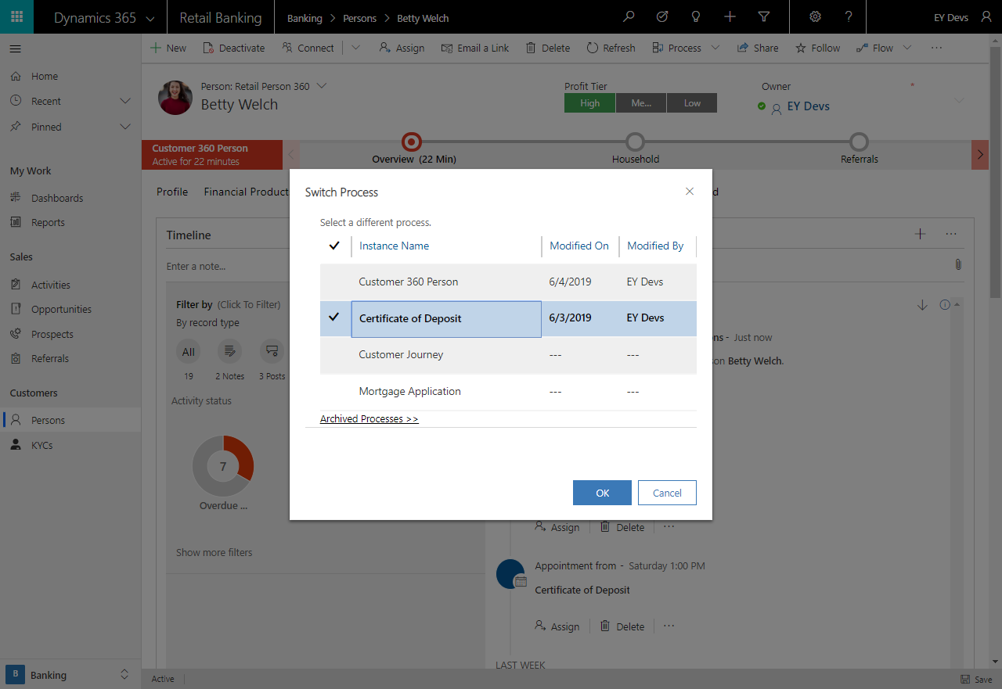

Slide 28
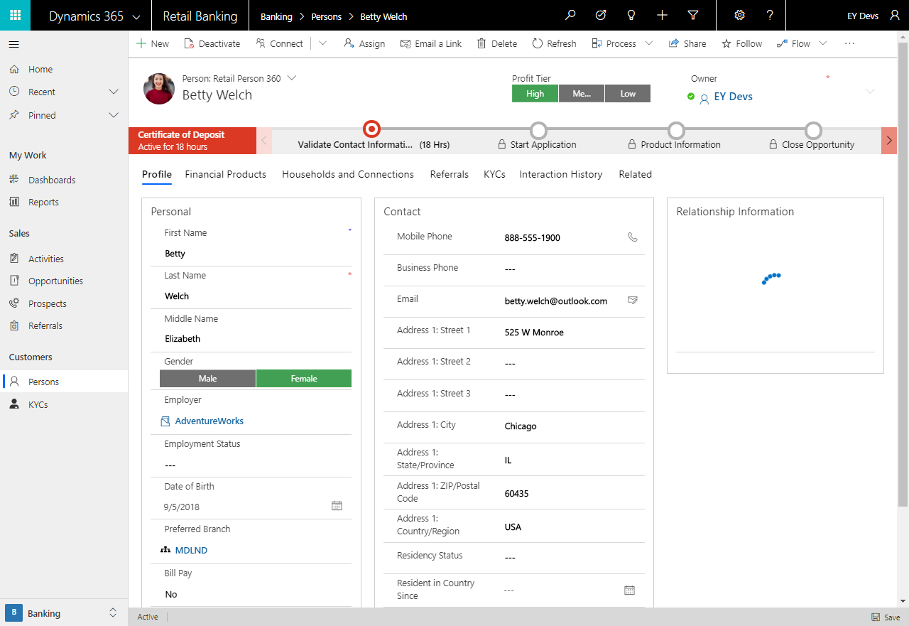

Slide 29
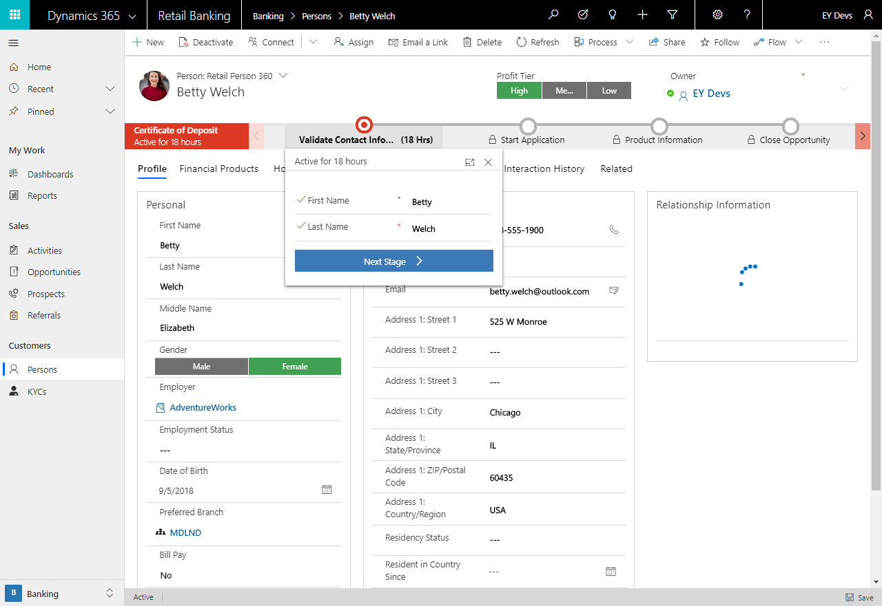

Slide 30
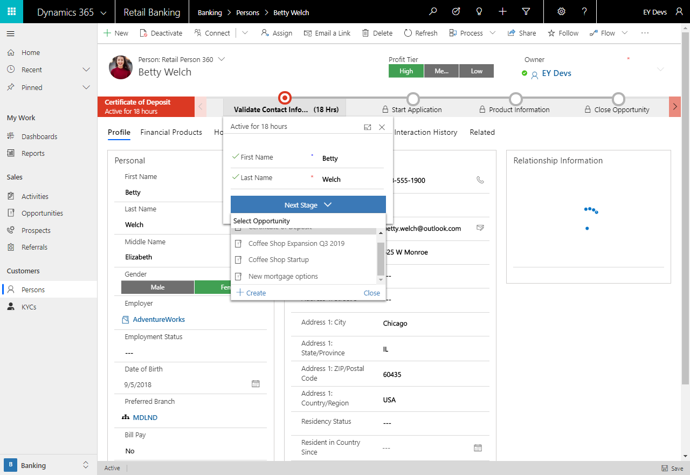

Slide 31
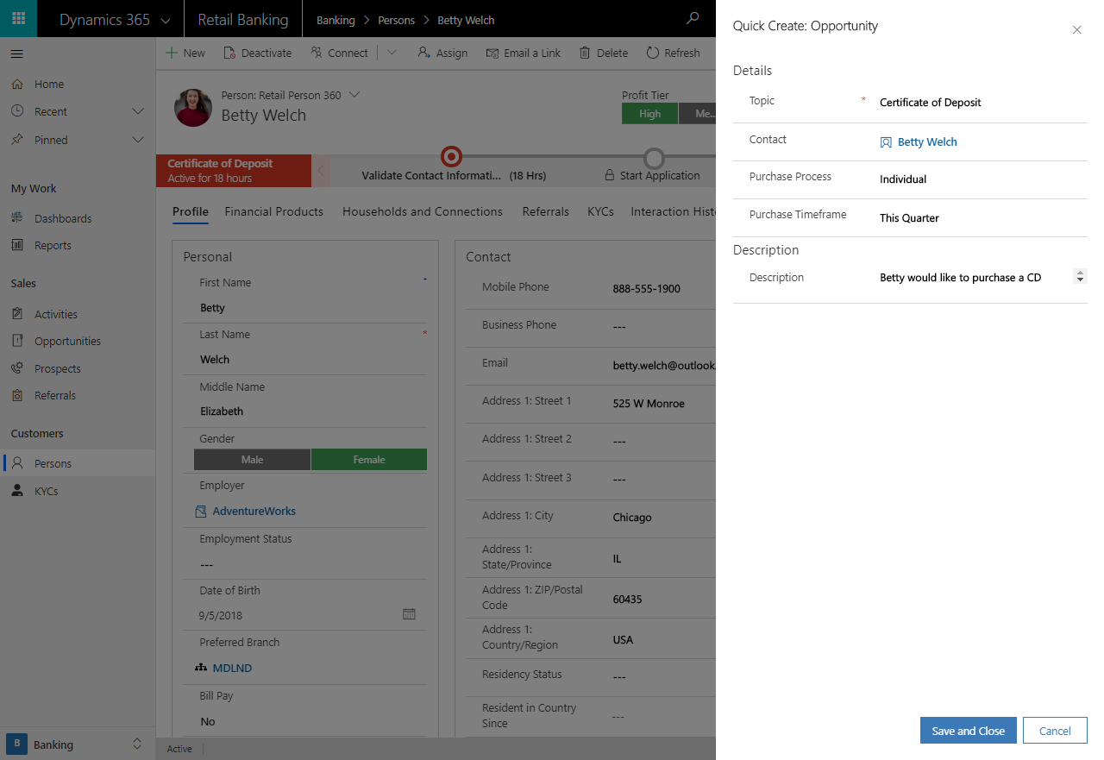

Slide 32
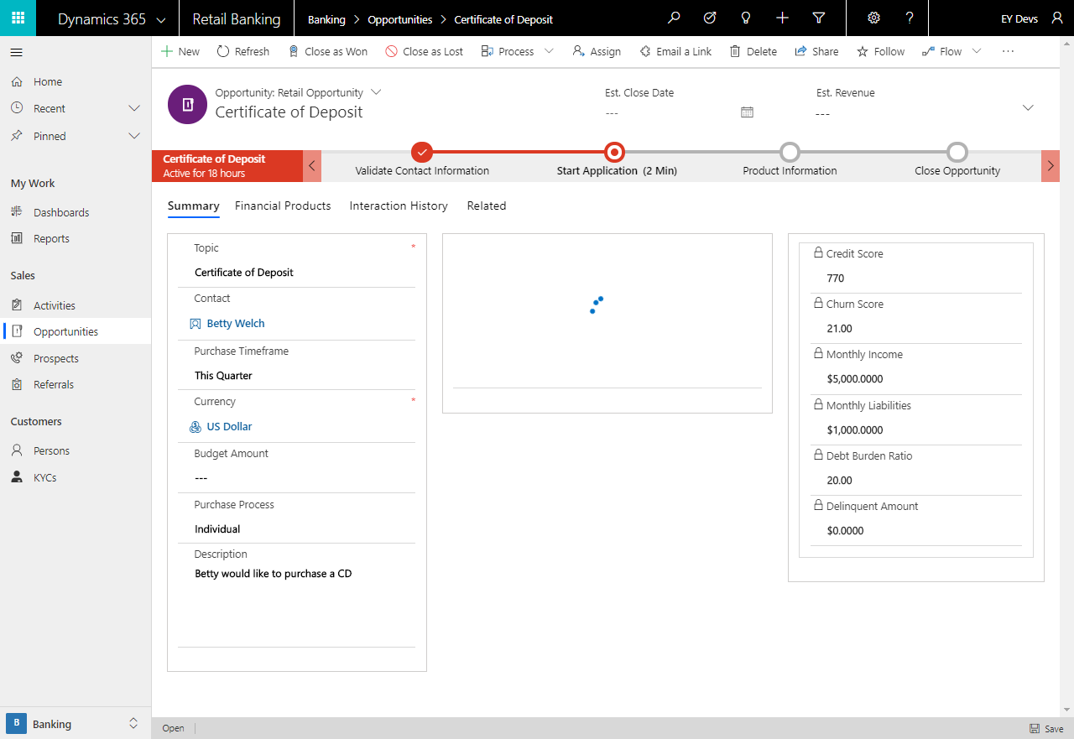

Slide 33
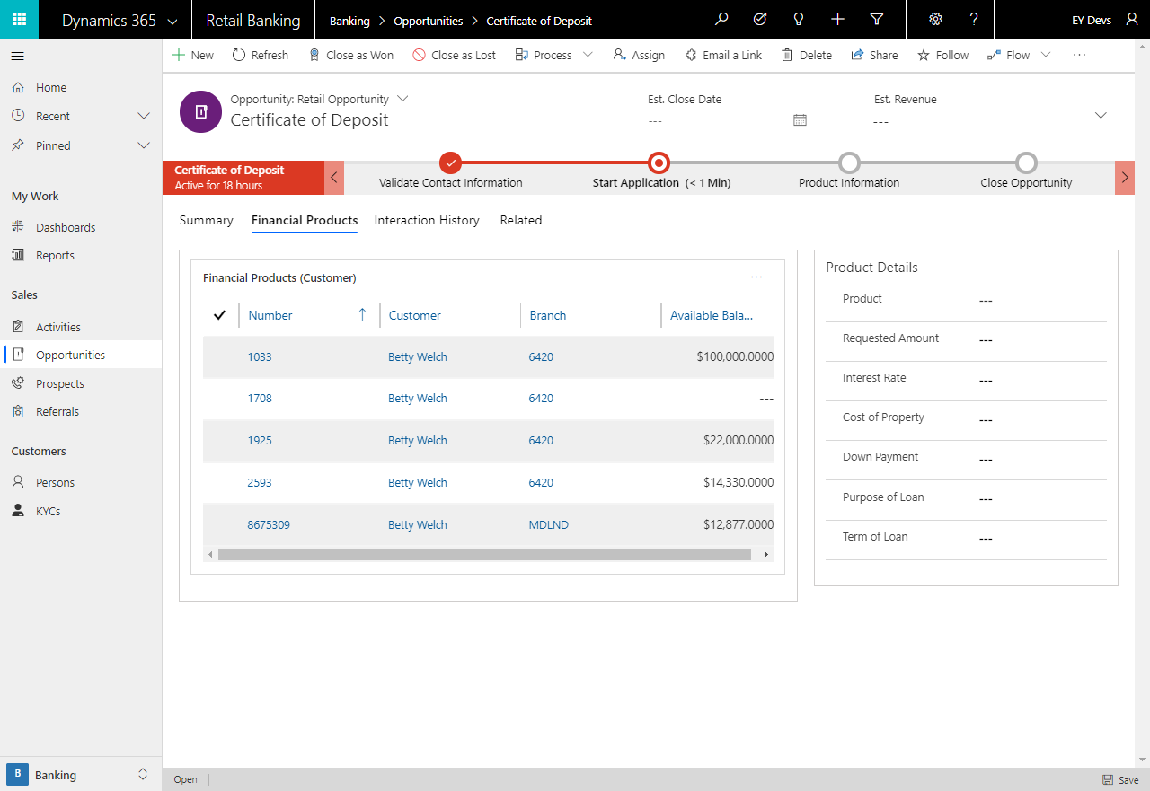

Slide 34
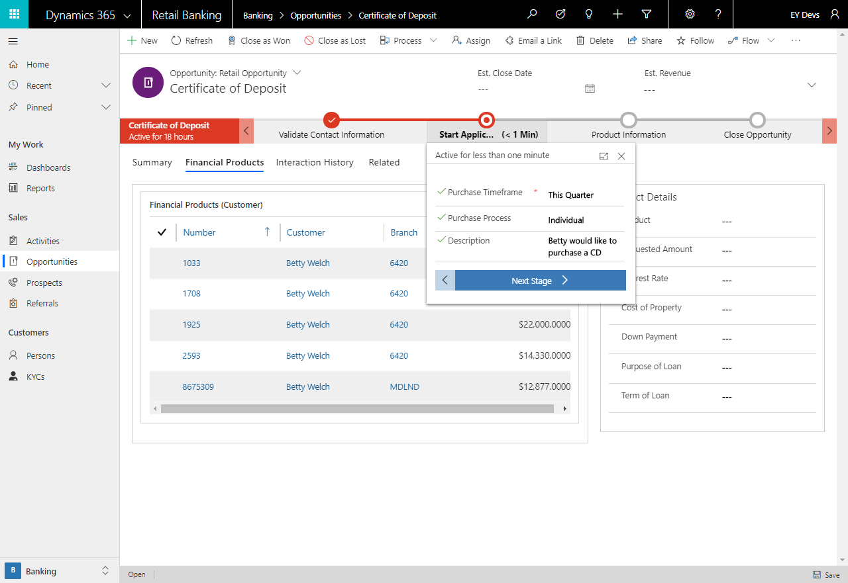

Slide 35
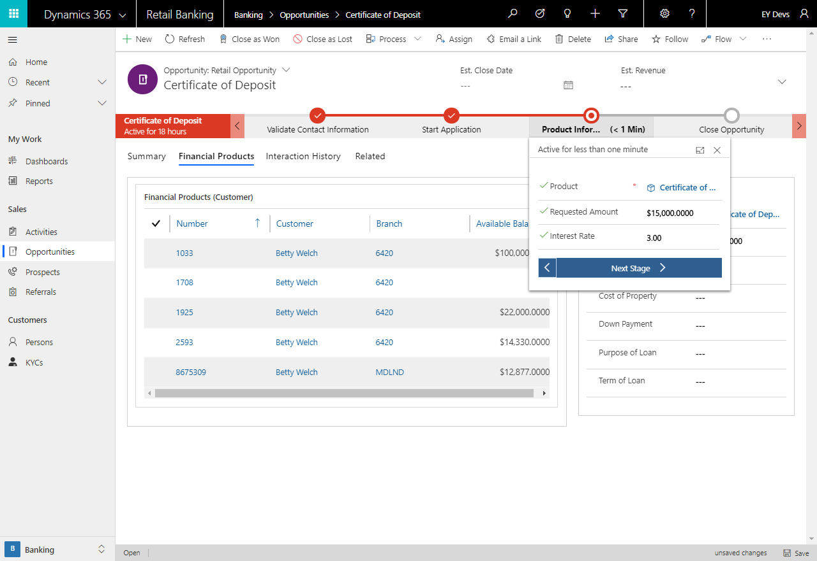

Slide 36
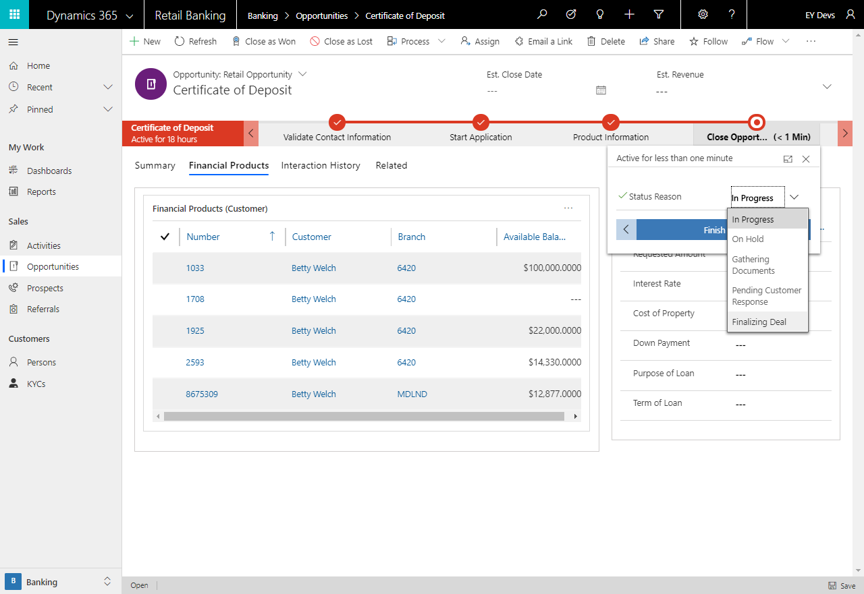

Slide 37
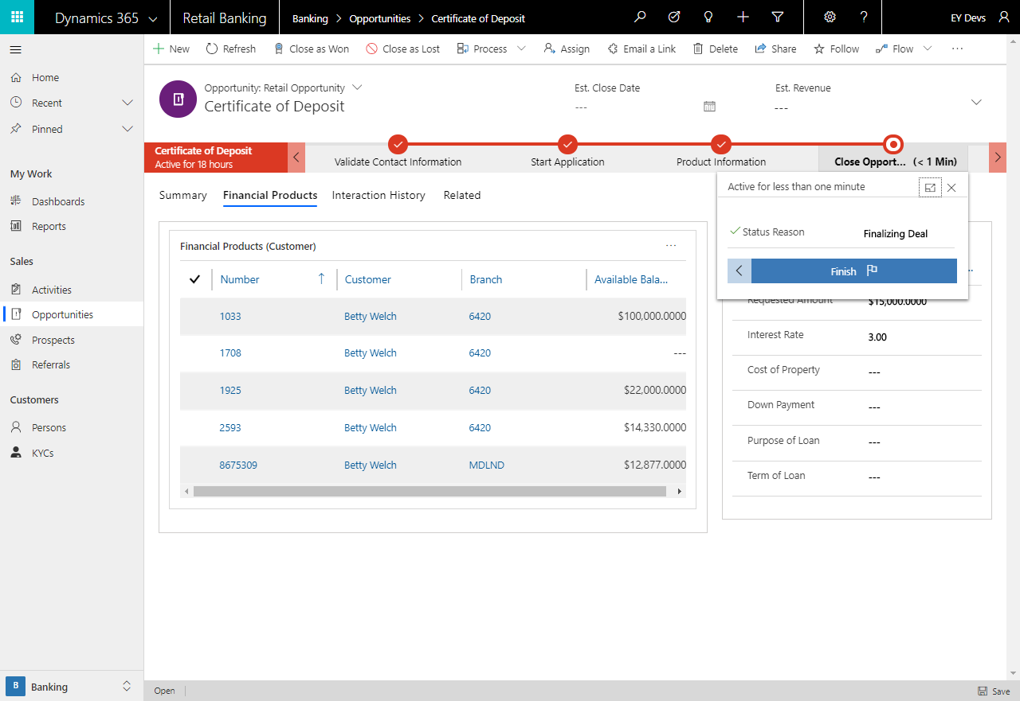

Slide 38
At this stage, Betty mentions that she is also in need of a small business loan for her company Coffee Inc.
Click Back into the record for Betty Welsh to review her Customer 360 again. View the Referrals tab and select Add New Prospect.

Slide 39
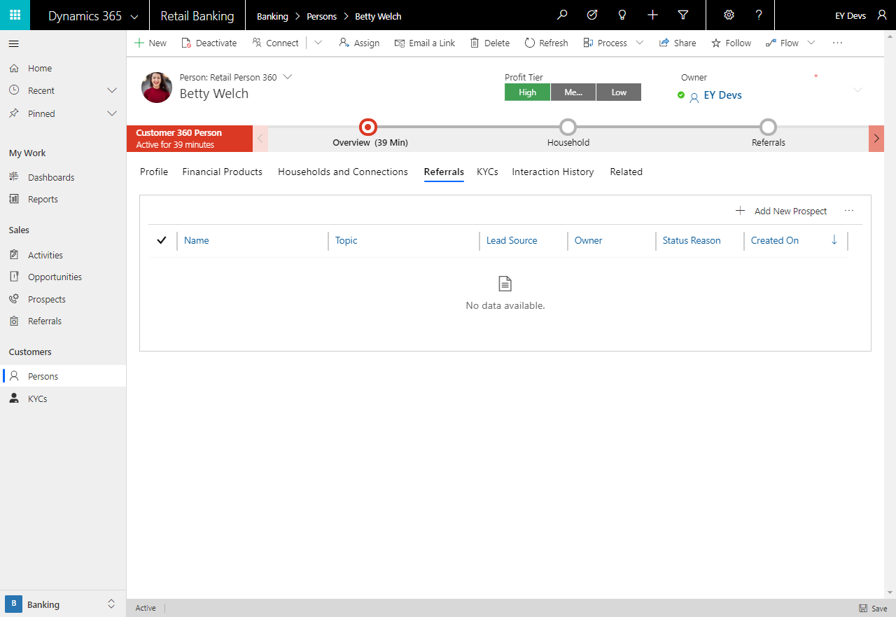

Slide 40
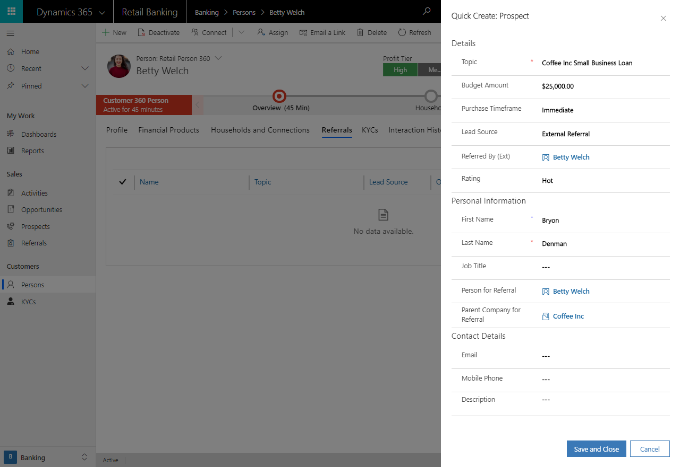

Slide 41
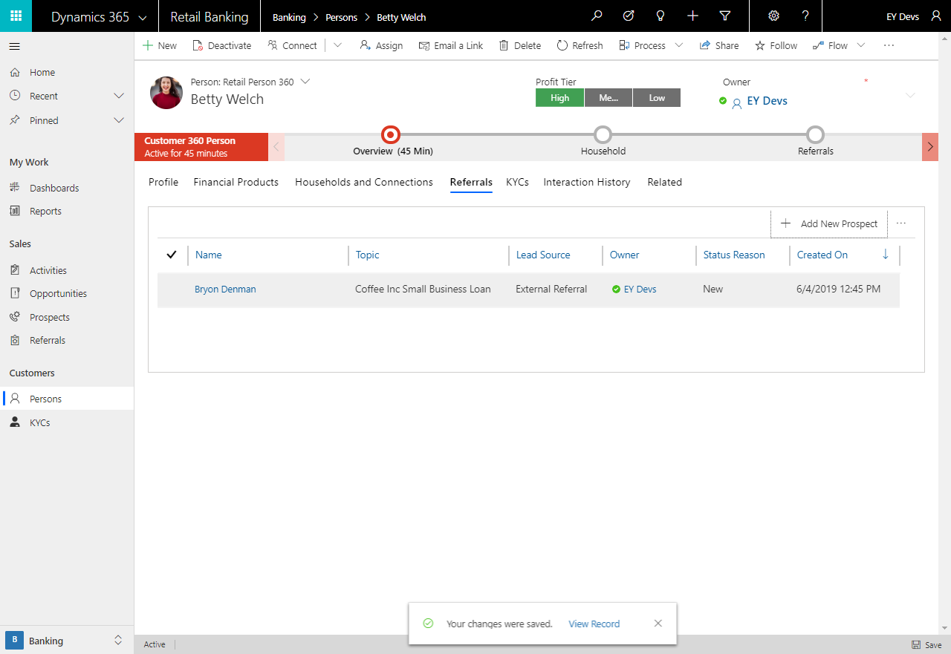

Slide 42
Commercial Relationship Manager
The Commercial Relationship Manager logs in to view the Commercial Relationship Manager dashboard and review the information. They see that they have a new lead so they log in to review.

Slide 43
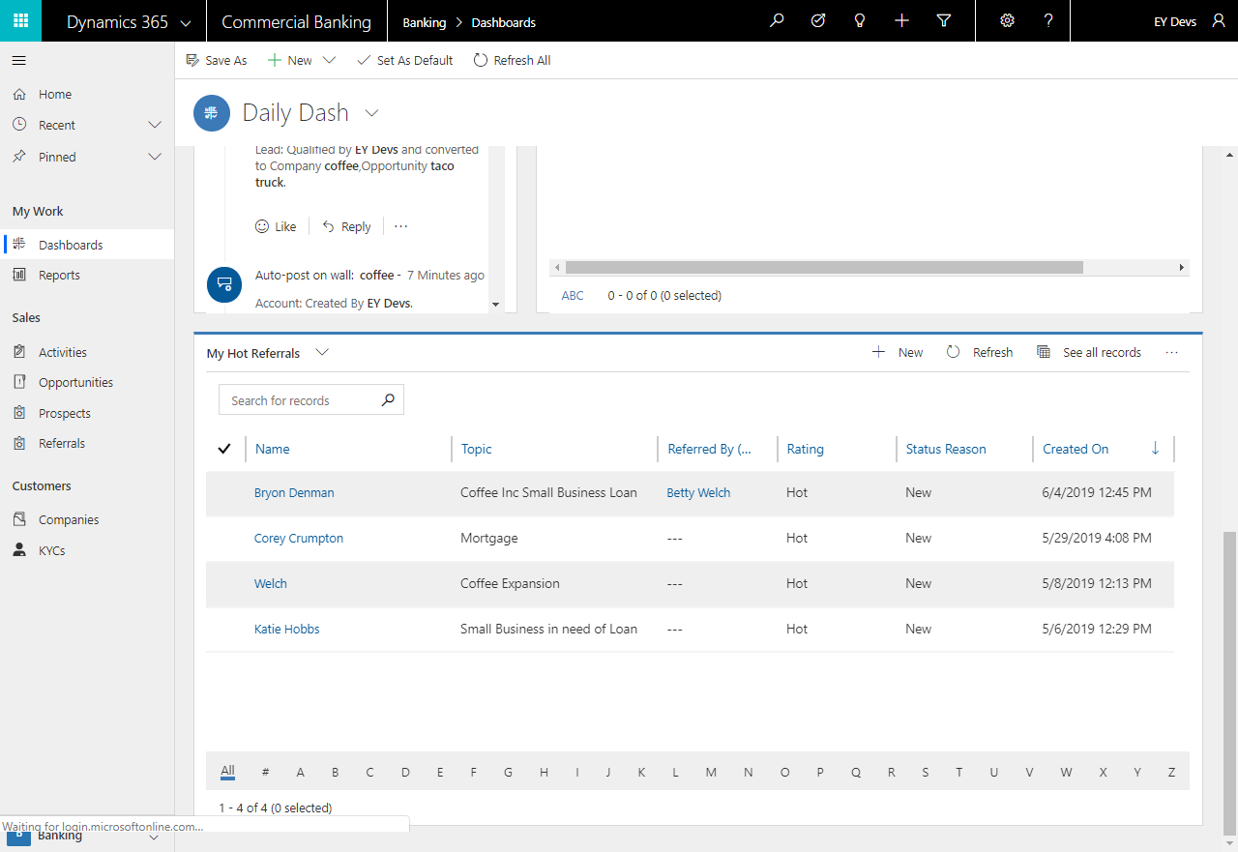

Slide 44
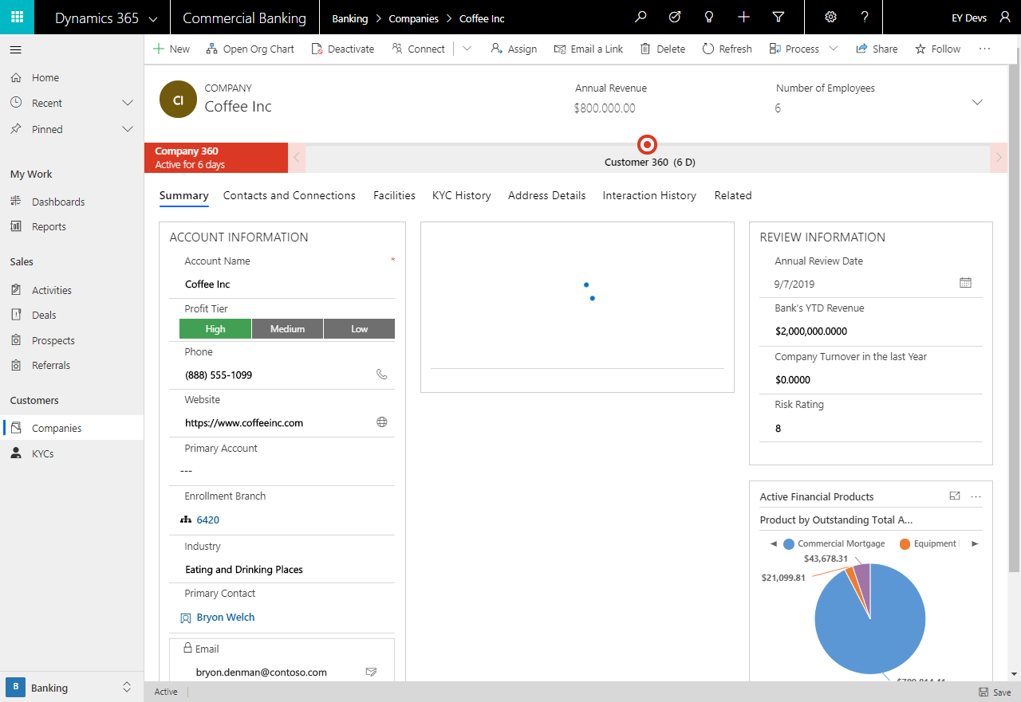

Slide 45
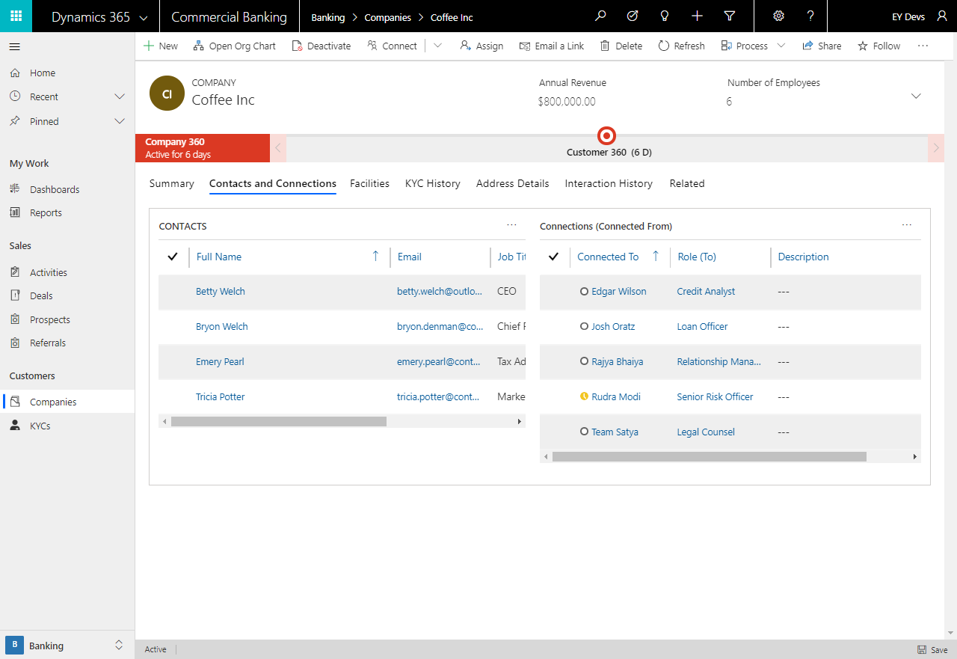

Slide 46
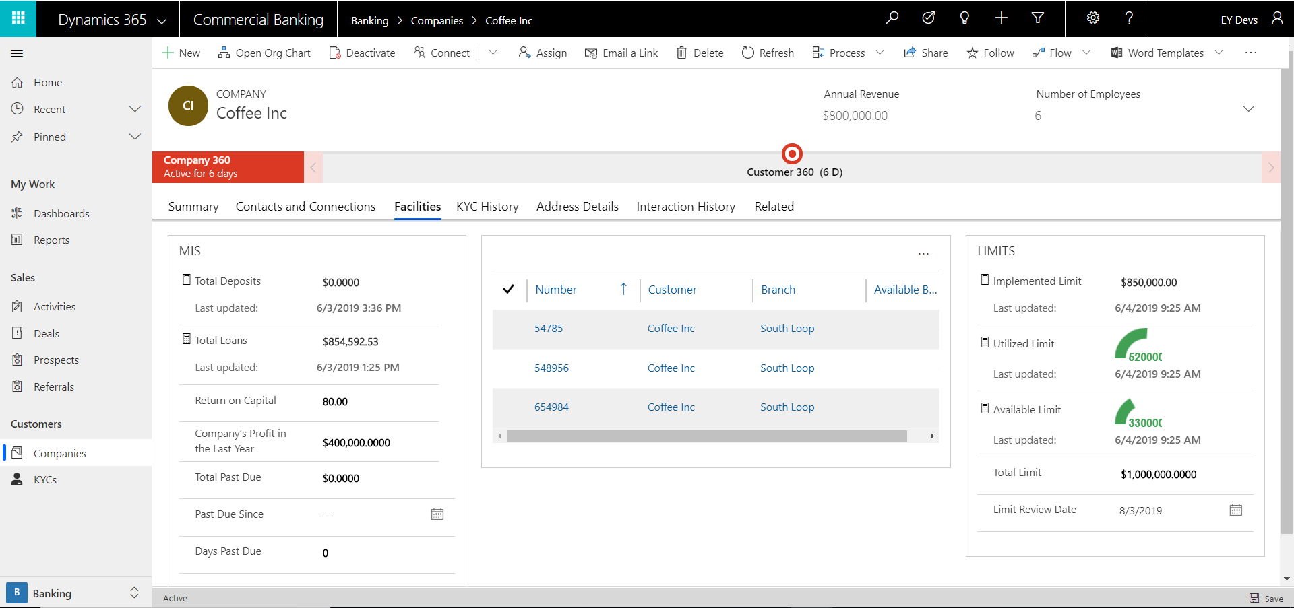

Slide 47
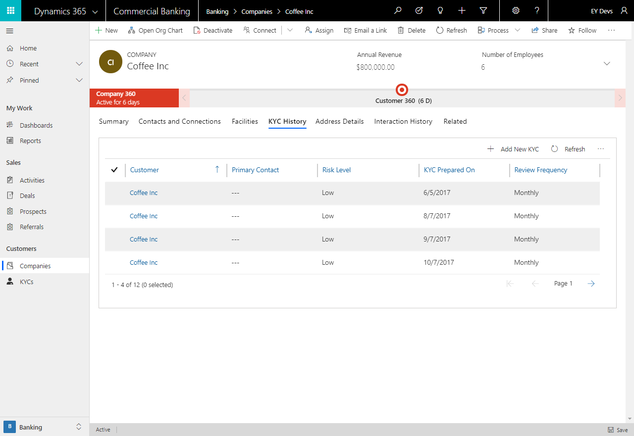

Slide 48
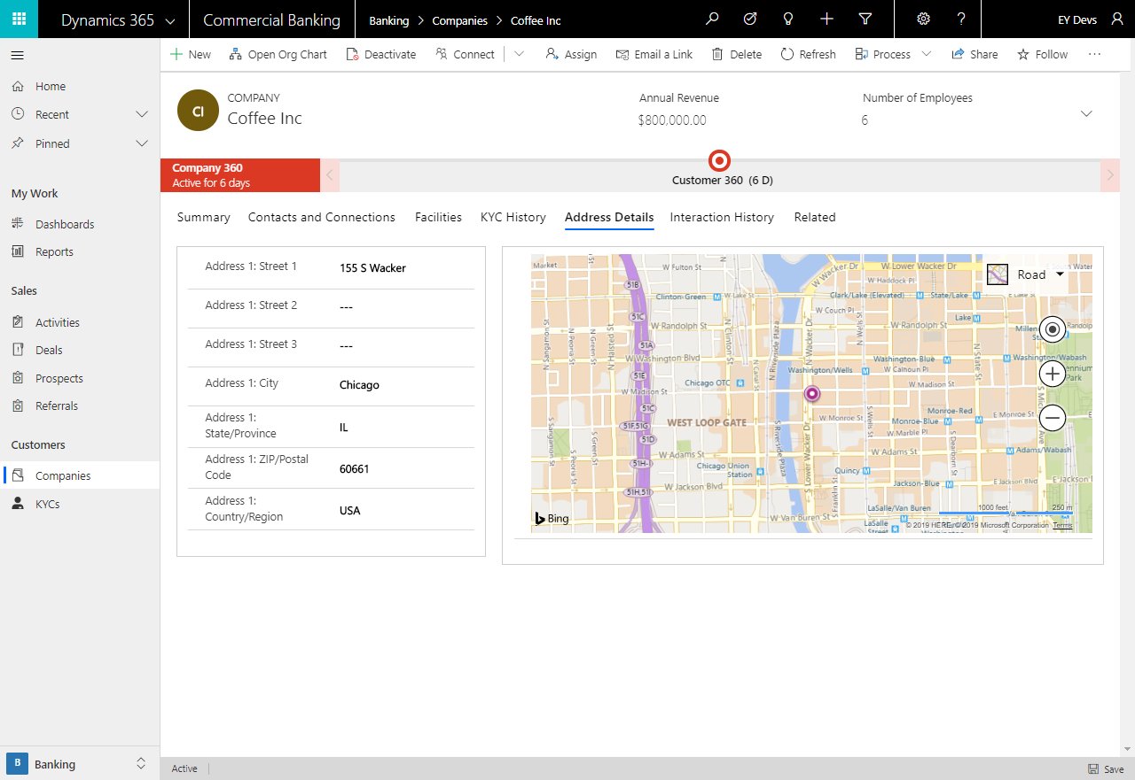

Slide 49
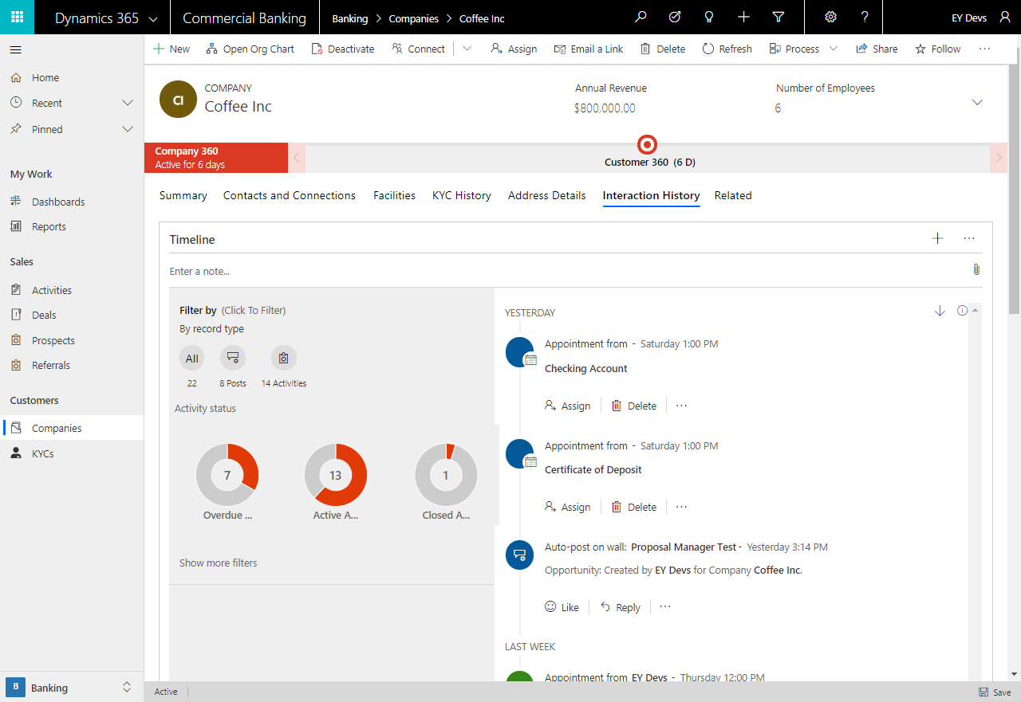

Slide 50
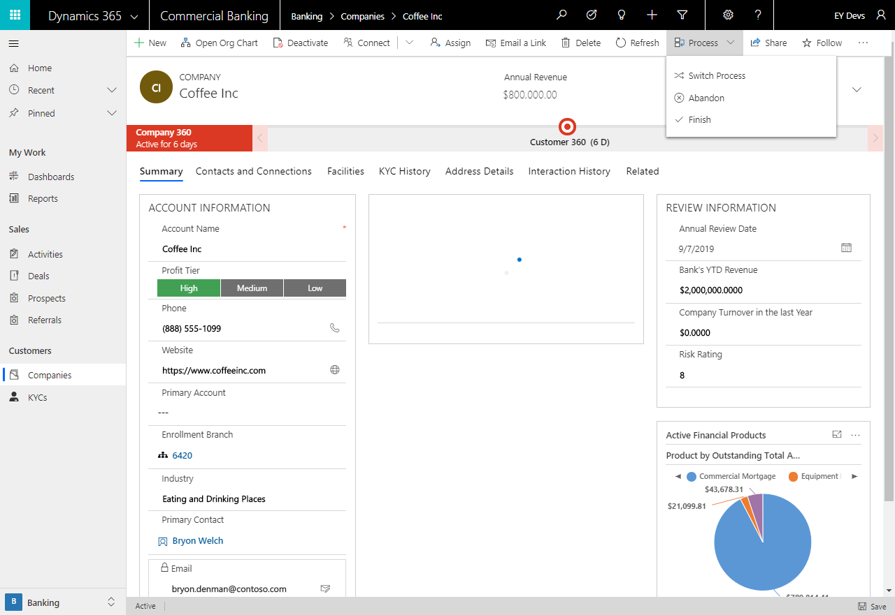

Slide 51
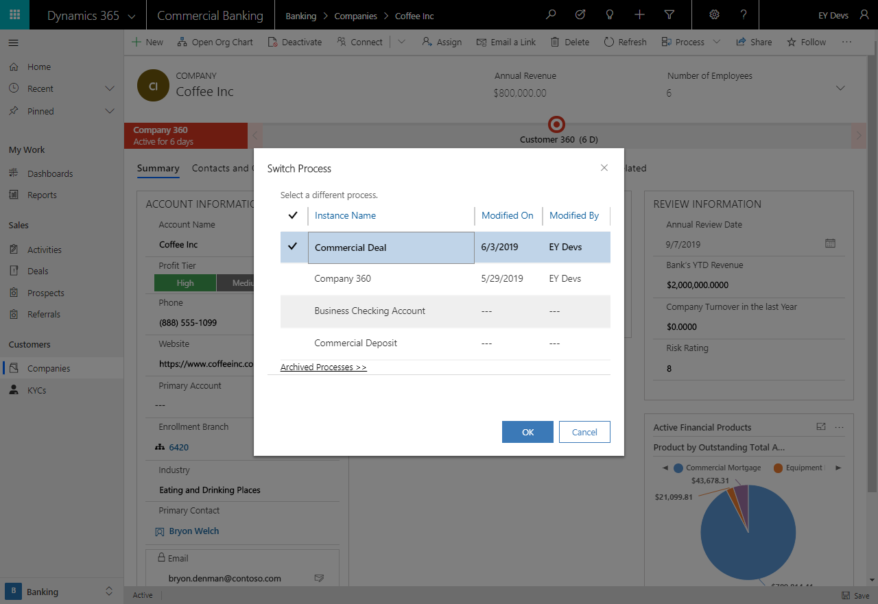

Slide 52
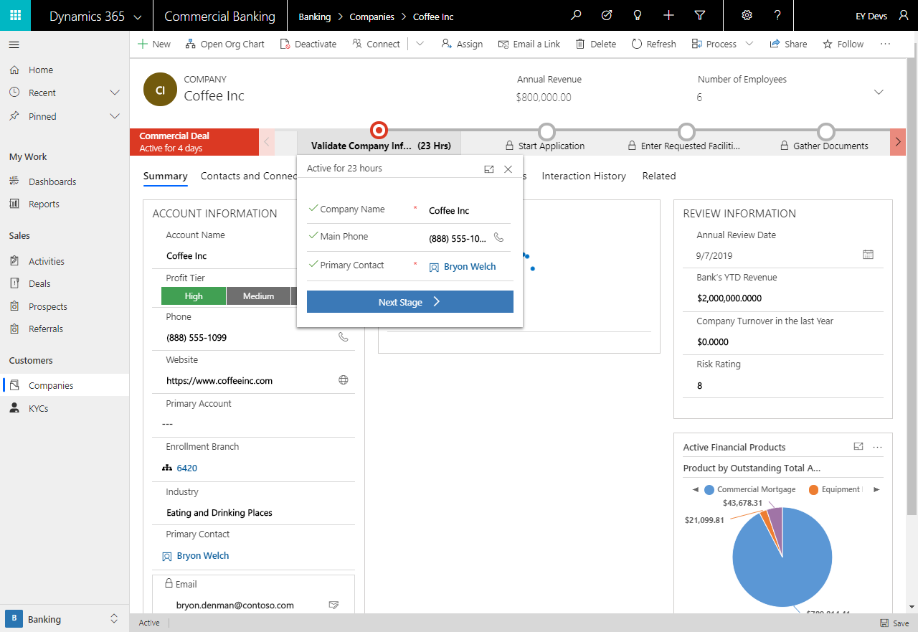

Slide 53
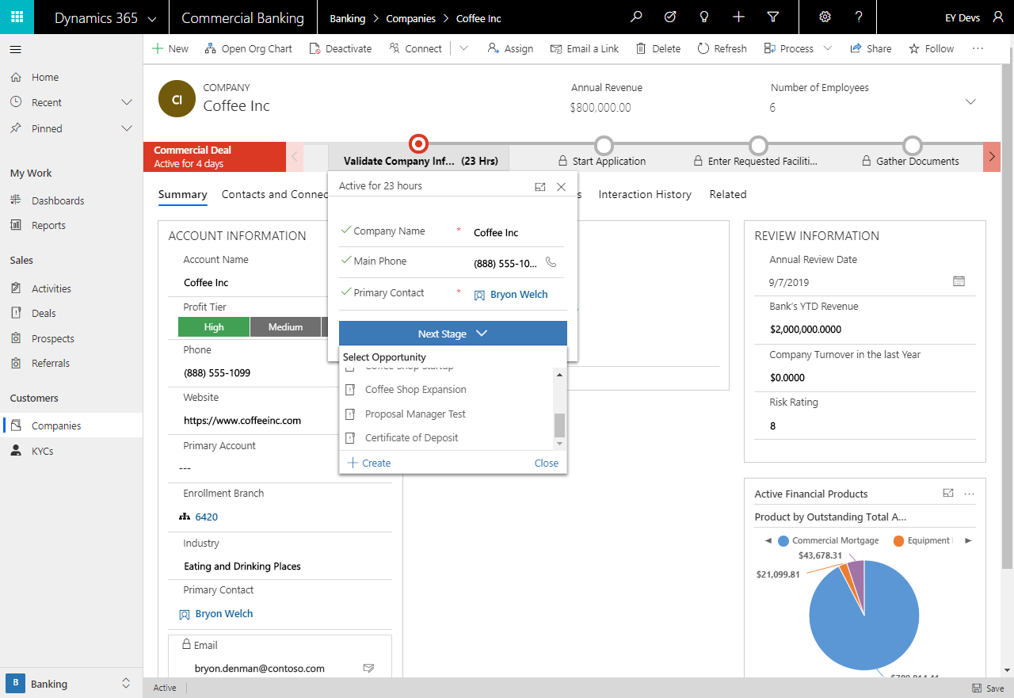

Slide 54
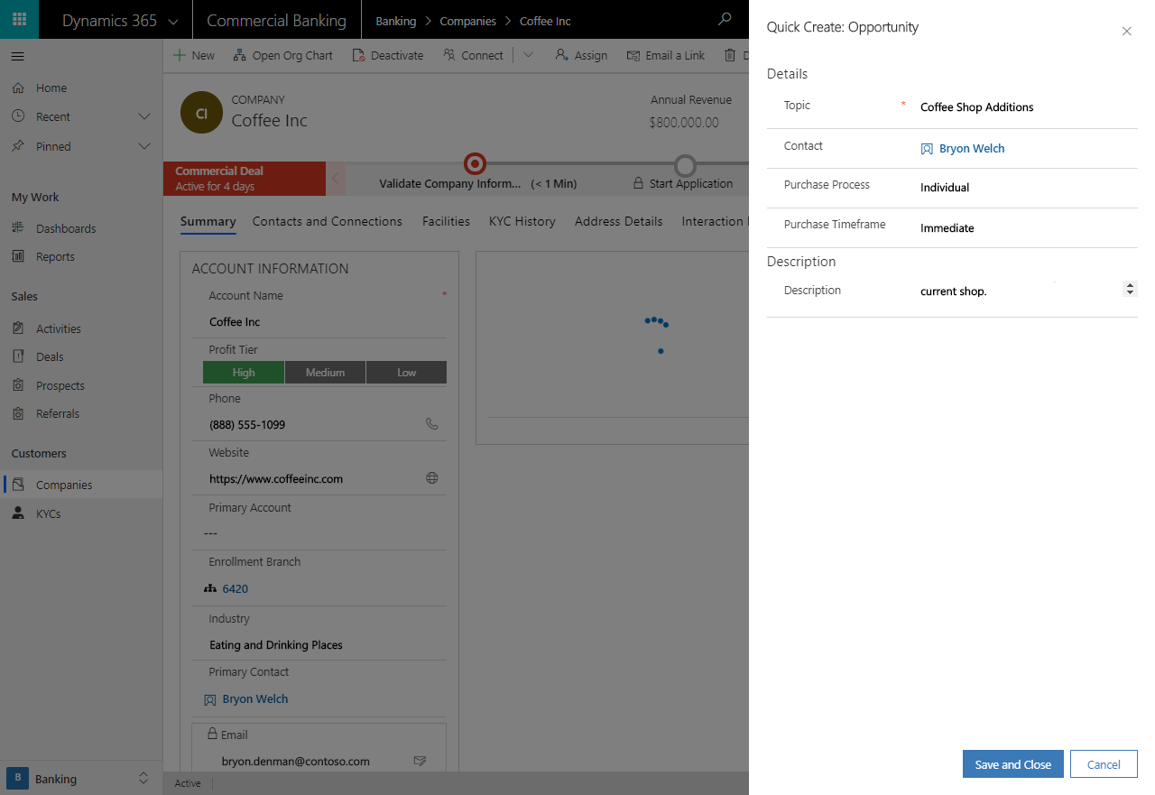

Slide 55
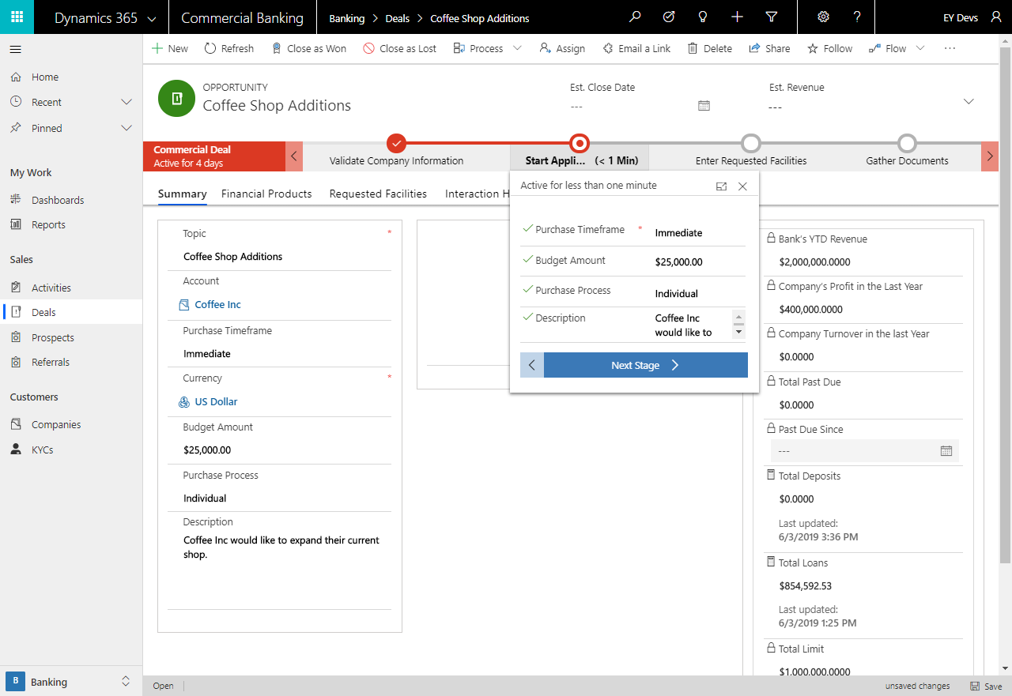

Slide 56
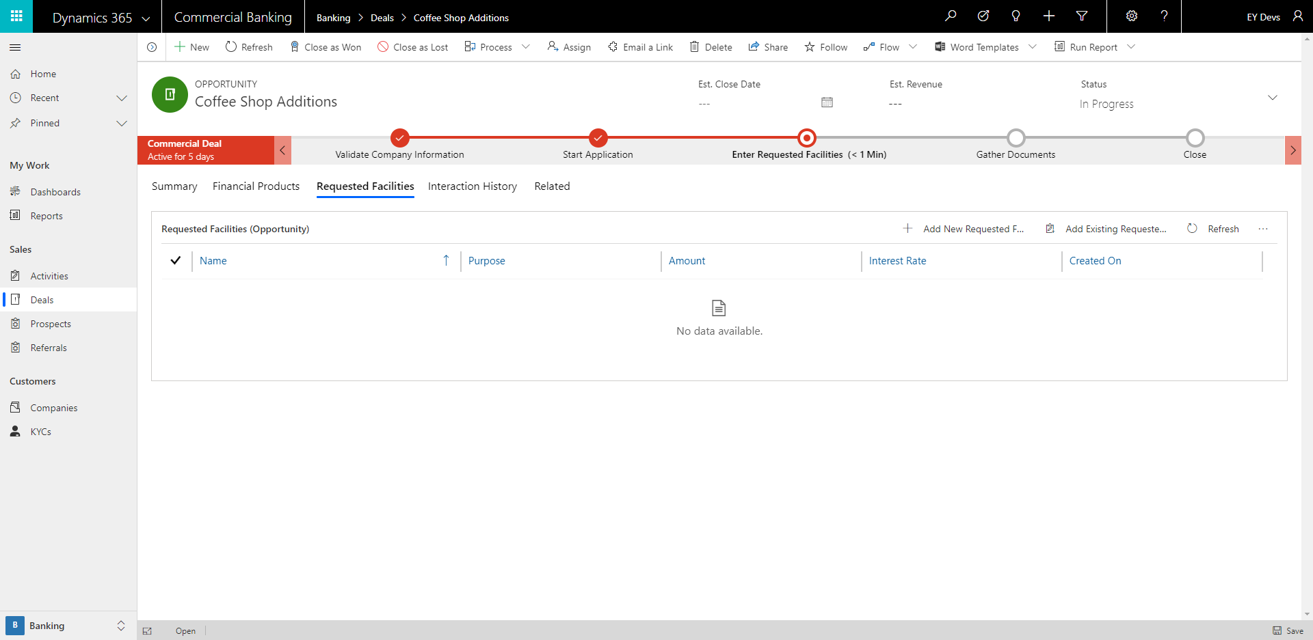

Slide 57
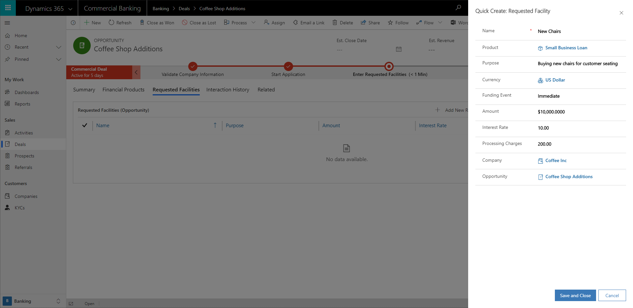

Slide 58


Slide 59


Slide 60


Slide 61


Slide 62


Slide 63


Slide 64


Slide 65


Slide 66
A Branch Manager may want to review all of the Applications and the progress over time. In this case, they can review the Application Overview Dashboard from Power BI within CRM in the Retail or Commercial Banking Applications. (there are 5 pages in this dashboard so make sure you are showing the 5 of 5 page to show the commercial information).

Slide 67


Slide 68
Retail Relationship Manager
The Retail Relationship Manager uses the Banking PowerApp to check appointments, referrals, and people. If during an appointment with a client, the Relationship Manager gets a referral, it can be entered into the app and it will appear in the system.

Slide 69


Slide 70


Slide 71


Slide 73


Slide 74


Slide 75


